Slide 1

Database Management Systems
UNIT-II
DBMS -UNIT-2

Slide 2
Introduction to the Relational Model
Unit-II
DBMS -UNIT-2

Slide 3
UNIT-II
Data Definition Language, Integrity constraint over relations, Types of Integrity Constraints Domain Constraint-String, character, Integer, date, Entity Integrity Constraint-, Primary Key, Referential Integrity Constraint-Foreign Key, Other Key Constraint – NULL,NOT NULL,CHECK and etc , querying relational data, logical data base design, introduction to views, destroying/altering tables and views.
DBMS -UNIT-2

Slide 4
INTRODUCTION TO THE RELATIONAL MODEL
The main construct for representing data in the relational model is a relation.
Relational database: a set of relations
Relation: made up of 2 parts:
Relation schema and relational instance.
  Instance : a table, with rows and columns.
  Set of tuples also called as records
  #Rows = cardinality, #fields = degree /arity.
  A domain is referred by domain name consisting of set of associated values.
  Schema : specifies name of relation, plus name and type of each column.
    E.G. Students (sid: string, name: string, login: string, age: integer,
gpa: real).
Can think of a relation as a set of rows or tuples (i.e., all rows are distinct).
All modern database management systems like SQL, MS SQL Server, IBM DB2, ORACLE, My-SQL, and Microsoft Access are based on RDBMS.
DBMS -UNIT-2

Slide 5
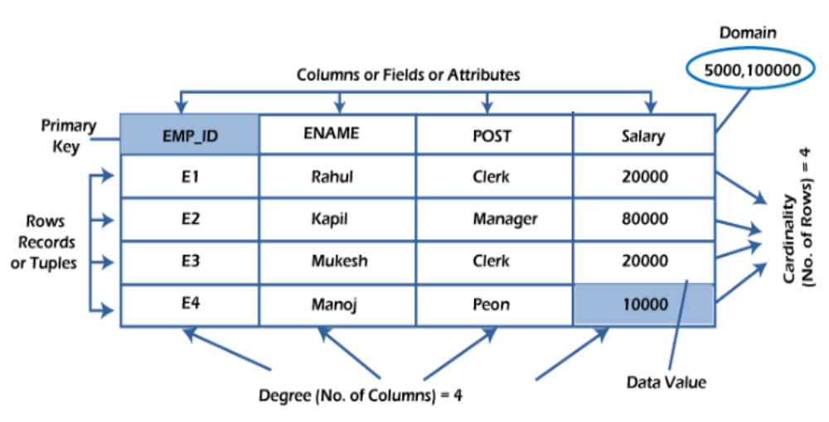
various terminologies of RDBMS
DBMS -UNIT-2

Slide 6
Relational Database Management System
RDBMS stands for Relational Database Management System. RDBMS is the basis for SQL, and for all modern database systems like MS SQL Server, IBM DB2, Oracle, MySQL, and Microsoft Access.
A Relational database management system (RDBMS) is a database management system (DBMS) that is based on the relational model as introduced by E. F. Codd in 1970.
DBMS -UNIT-2

Slide 7
Relational Model Concepts
Attribute: Each column in a Table. Attributes are the properties which define a relation. e.g., Student_Rollno, NAME,etc.
Tables – In the Relational model the, relations are saved in the table format. It is stored along with its entities. A table has two properties rows and columns. Rows represent records and columns represent attributes.
Tuple – It is nothing but a single row of a table, which contains a single record.
Relation Schema: A relation schema represents the name of the relation with its attributes.
Degree (Arity): The total number of attributes which in the relation is called the degree of the relation.
Cardinality: Total number of rows present in the Table.
Column: The column represents the set of values for a specific attribute.
Relation instance – Relation instance is a finite set of tuples in the RDBMS system. Relation instances never have duplicate tuples.
Relation key - Every row has one, two or multiple attributes, which is called relation key.
Attribute domain – Every attribute has some pre-defined value and scope which is known as attribute domain
DBMS -UNIT-2

Slide 8
Example Instance of Students Relation
An instance of a relation is a set of tuples, also called records, in which each tuple has the same number of fields as the relation schema.
A relation instance can be thought of as a table in which each tuple is a
row, and all rows have the same number of fields.
Cardinality =3, degree =5, all rows distinct
sid | name | login | age | gpa
53666 | Jones | jones@cs | 18 | 3.4
53688 | Smith | smith@eecs | 18 | 3.2
53650 | Smith | smith@math | 19 | 3.8
DBMS -UNIT-2

Slide 9
SQL (Structured Query Language)
DBMS -UNIT-2

Slide 10
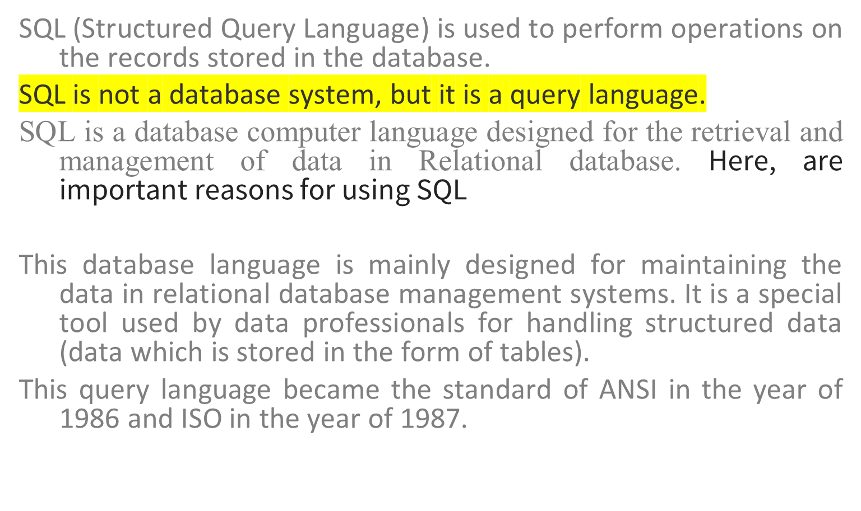
SQL (Structured Query Language)
DBMS -UNIT-2

Slide 11
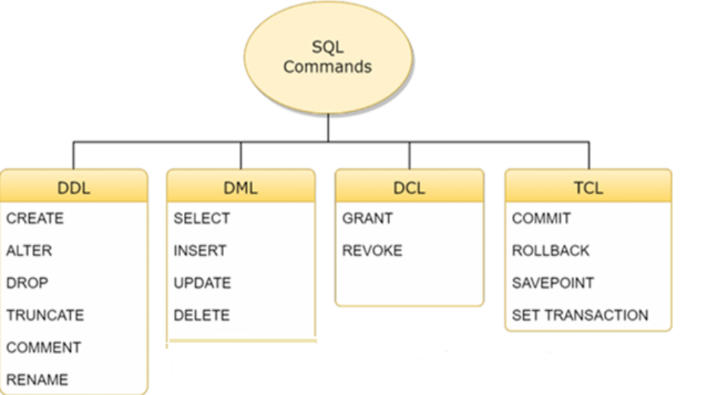
SQL commands are divided into four subgroups, DDL, DML, DCL, and TCL
DBMS -UNIT-2

Slide 12
SQL (Structured Query Language)
To create a column/field, to store, maintain and manipulate data, the sql engine requires a minimum of 3 parameters to be passed by the programmer.
Column name
Data type
Size
DBMS -UNIT-2

Slide 13
MySQL Data Types
In MySQL there are three main data types: string, numeric, and date and time.
String Data Types
Data type | Description
CHAR(size) | A FIXED length string (can contain letters, numbers, and special characters). The size parameter specifies the column length in characters - can be from 0 to 255. Default is 1
VARCHAR(size) | A VARIABLE length string (can contain letters, numbers, and special characters). The size parameter specifies the maximum column length in characters - can be from 0 to 65535
BINARY(size) | Equal to CHAR(), but stores binary byte strings. The size parameter specifies the column length in bytes. Default is 1
DBMS -UNIT-2

Slide 14
Numeric Data Types
Data type | Description
BIT(size) | A bit-value type. The number of bits per value is specified in size. The size parameter can hold a value from 1 to 64. The default value for size is 1.
TINYINT(size) | A very small integer. Signed range is from -128 to 127. Unsigned range is from 0 to 255. The size parameter specifies the maximum display width (which is 255)
BOOL | Zero is considered as false, nonzero values are considered as true.
BOOLEAN | Equal to BOOL
SMALLINT(size) | A small integer. Signed range is from -32768 to 32767. Unsigned range is from 0 to 65535. The size parameter specifies the maximum display width (which is 255)
MEDIUMINT(size) | A medium integer. Signed range is from -8388608 to 8388607. Unsigned range is from 0 to 16777215. The size parameter specifies the maximum display width (which is 255)
INT(size) | A medium integer. Signed range is from -2147483648 to 2147483647. Unsigned range is from 0 to 4294967295. The size parameter specifies the maximum display width (which is 255)
DBMS -UNIT-2
INTEGER(size)
Equal to INT(size)

Slide 15
BIGINT(size) | A large integer. Signed range is from -9223372036854775808 to 9223372036854775807. Unsigned range is from 0 to 18446744073709551615. The size parameter specifies the maximum display width (which is 255)
FLOAT(size, d) | A floating point number. The total number of digits is specified in size. The number of digits after the decimal point is specified in the d parameter. This syntax is deprecated in MySQL 8.0.17, and it will be removed in future MySQL versions
FLOAT(p) | A floating point number. MySQL uses the p value to determine whether to use FLOAT or DOUBLE for the resulting data type. If p is from 0 to 24, the data type becomes FLOAT(). If p is from 25 to 53, the data type becomes DOUBLE()
DOUBLE(size, d) | A normal-size floating point number. The total number of digits is specified in size. The number of digits after the decimal point is specified in the d parameter
DOUBLE PRECISION(size, d)
DECIMAL(size, d) | An exact fixed-point number. The total number of digits is specified in size. The number of digits after the decimal point is specified in the d parameter. The maximum number for size is 65. The maximum number for d is 30. The default value for size is 10. The default value for d is 0.
DEC(size, d) | Equal to DECIMAL(size,d)
DBMS -UNIT-2

Slide 16
Date and Time Data Types
Data type | Description
DATE | A date. Format: YYYY-MM-DD. The supported range is from '1000-01-01' to '9999-12- 31'
DATETIME(fsp) | A date and time combination. Format: YYYY-MM-DD hh:mm:ss. The supported range is from '1000-01-01 00:00:00' to '9999-12-31 23:59:59'. Adding DEFAULT and ON UPDATE in the column definition to get automatic initialization and updating to the current date and time
TIMESTAMP(fsp) | A timestamp. TIMESTAMP values are stored as the number of seconds since the Unix epoch ('1970-01-01 00:00:00' UTC). Format: YYYY-MM-DD hh:mm:ss. The supported range is from '1970-01-01 00:00:01' UTC to '2038-01-09 03:14:07' UTC. Automatic initialization and updating to the current date and time can be specified using DEFAULT CURRENT_TIMESTAMP and ON UPDATE CURRENT_TIMESTAMP in the column definition
TIME(fsp) | A time. Format: hh:mm:ss. The supported range is from '-838:59:59' to '838:59:59'
YEAR | A year in four-digit format. Values allowed in four-digit format: 1901 to 2155, and 0000. MySQL 8.0 does not support year in two-digit format.
DBMS -UNIT-2

Slide 17
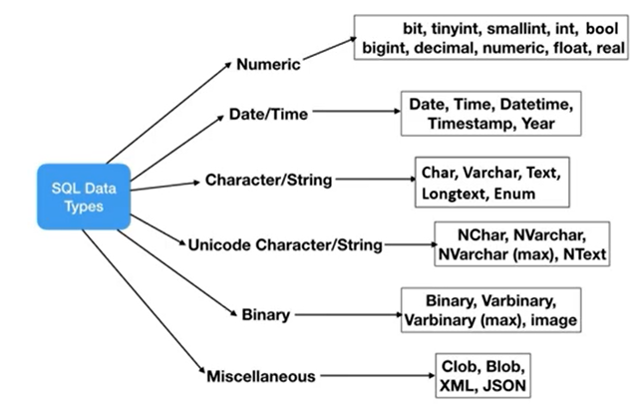
Data Types
DBMS -UNIT-2

Slide 18
DDL(Data Definition Language)
DDL is short name of Data Definition Language, which deals with database schemas and descriptions, of how the data should reside in the database.
CREATE - to create a database and its objects like (table, index, views, store procedure, function, and triggers)
ALTER - alters the structure of the existing database
DROP - delete objects from the database
TRUNCATE - remove all records from a table, including all spaces allocated for the records are removed
COMMENT - add comments to the data dictionary
RENAME - rename an object
DBMS -UNIT-2

Slide 19
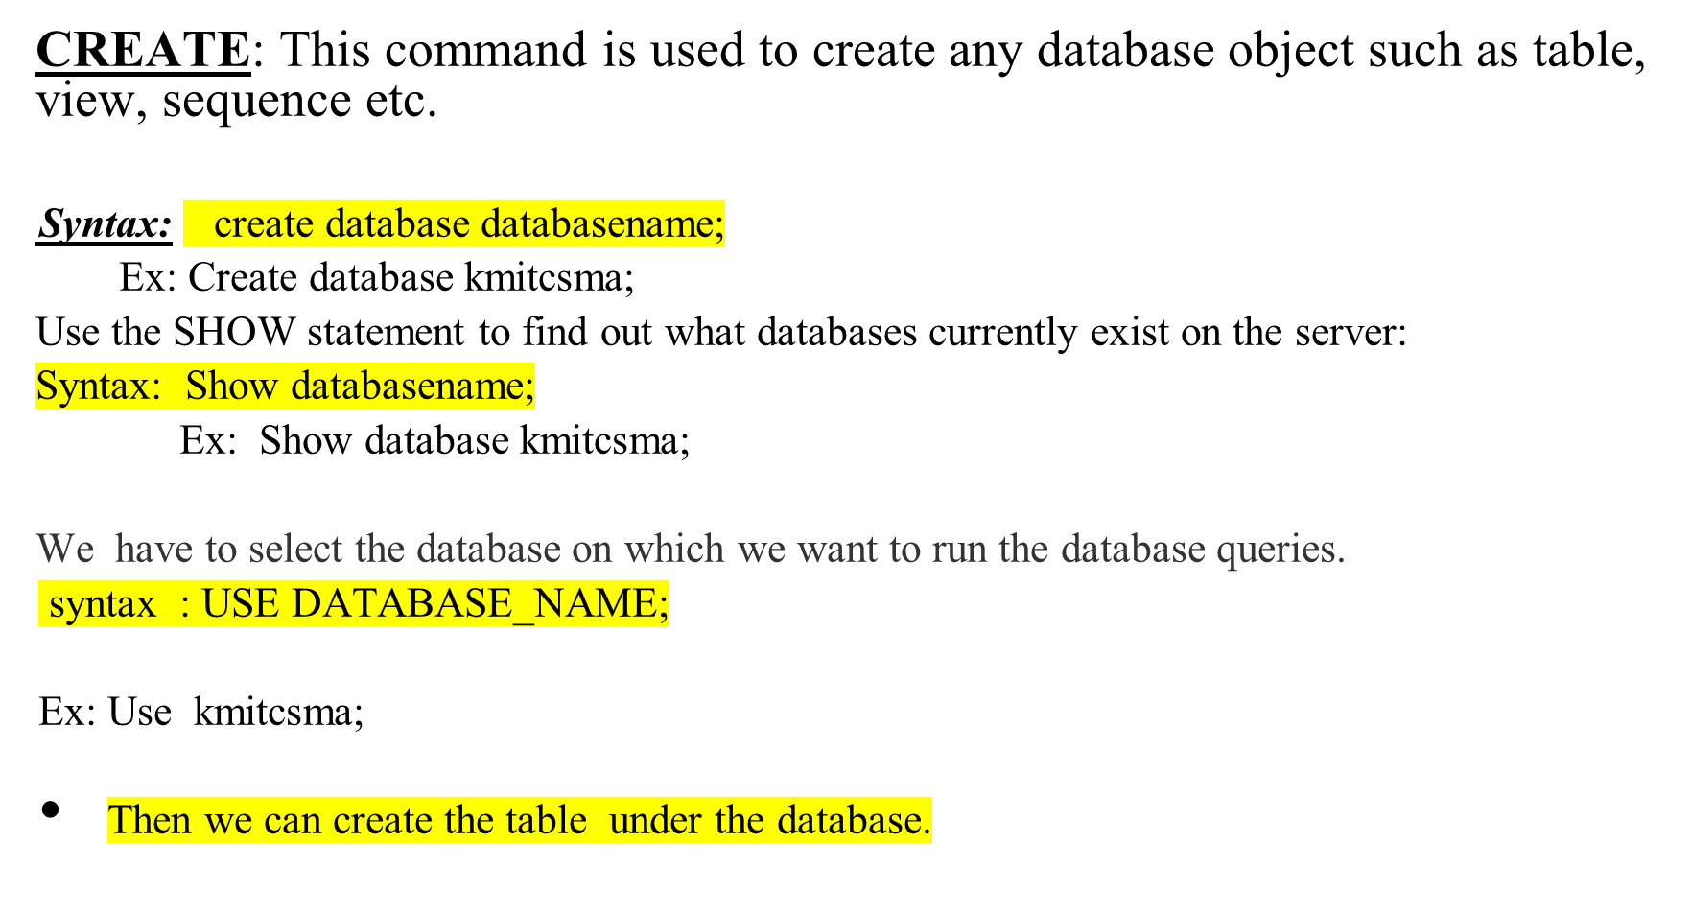
SQL CREATE DATABASE Statement
DBMS -UNIT-2

Slide 20
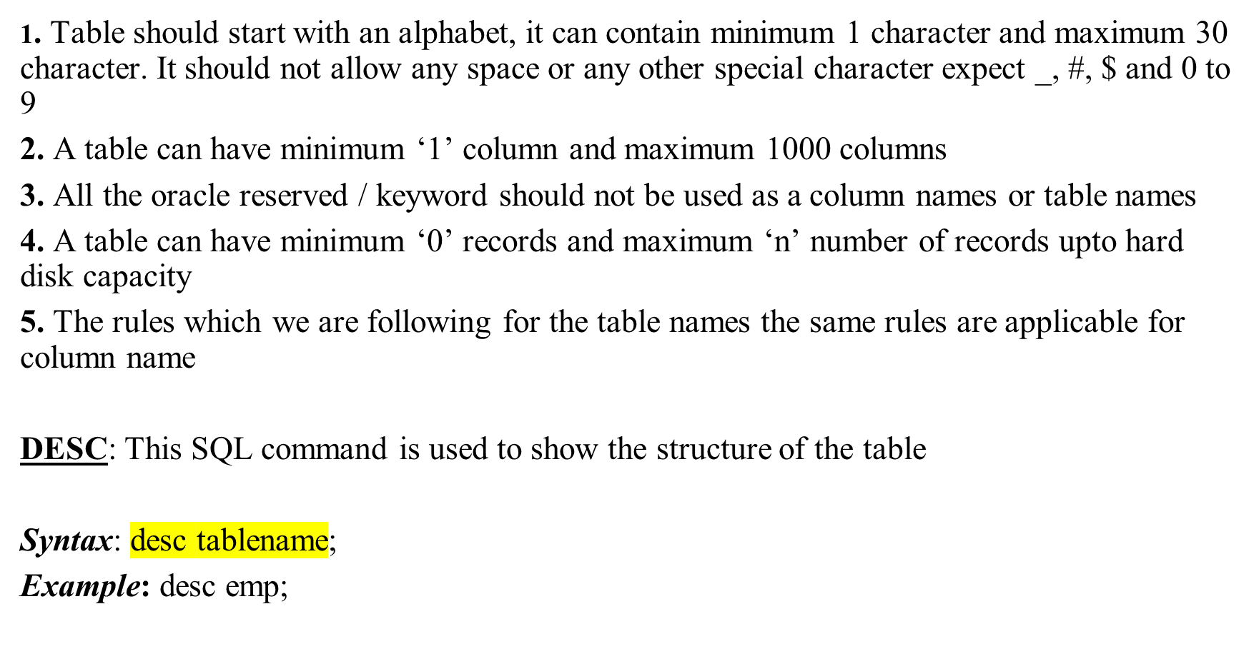
Rules for naming a table
DBMS -UNIT-2

Slide 21
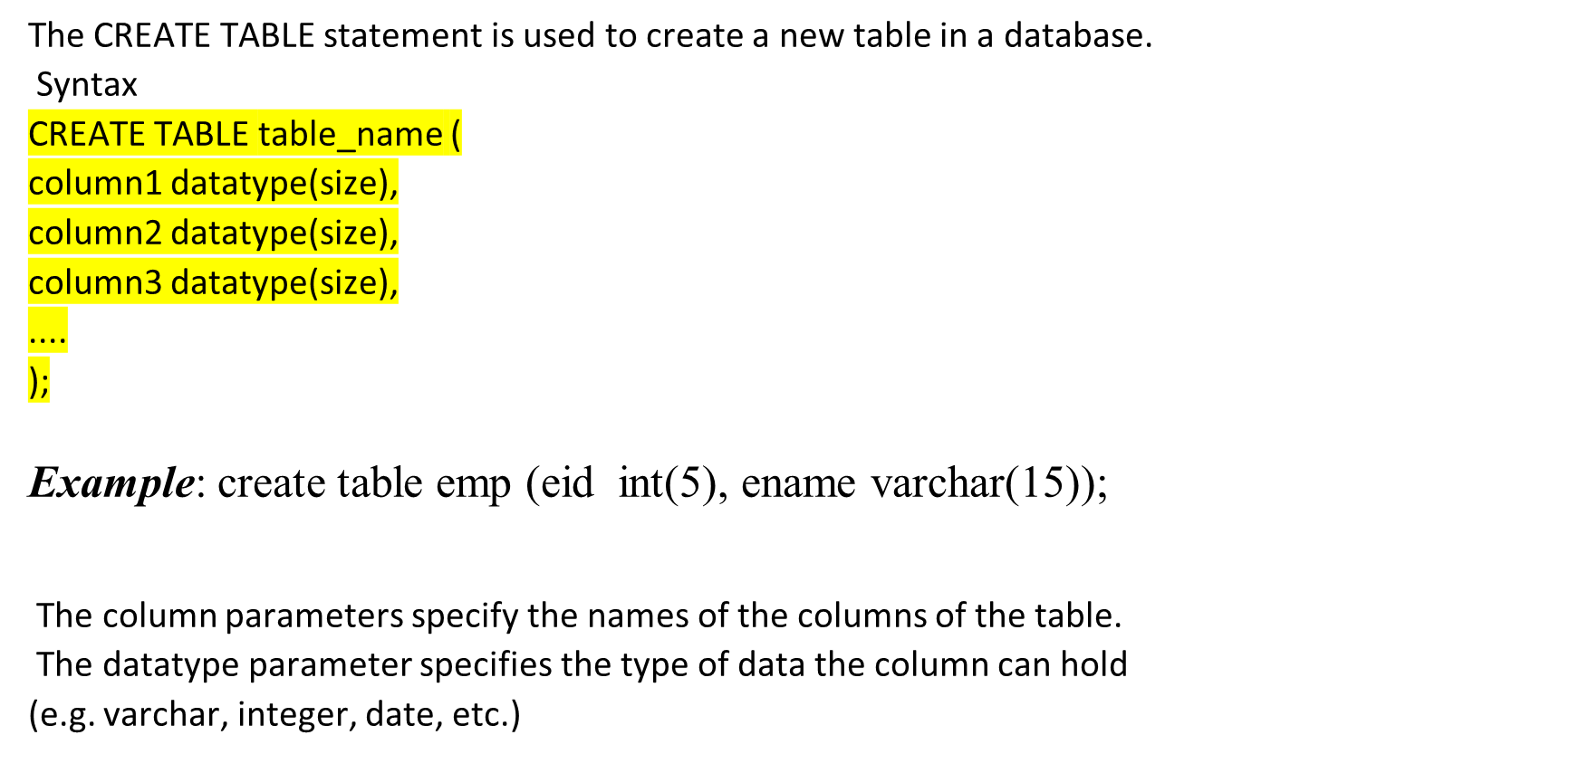
The SQL CREATE TABLE Statement
DBMS -UNIT-2

Slide 22
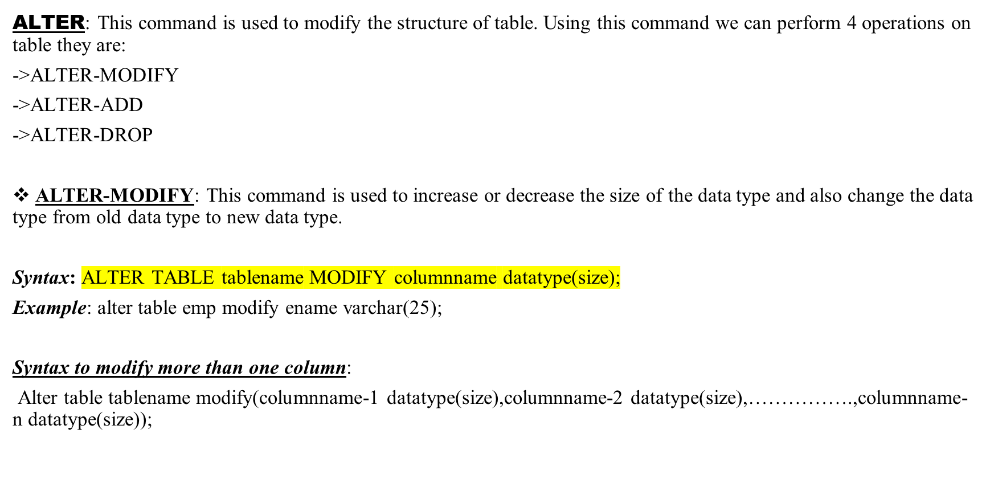
ALTER COMMAND
DBMS -UNIT-2

Slide 23
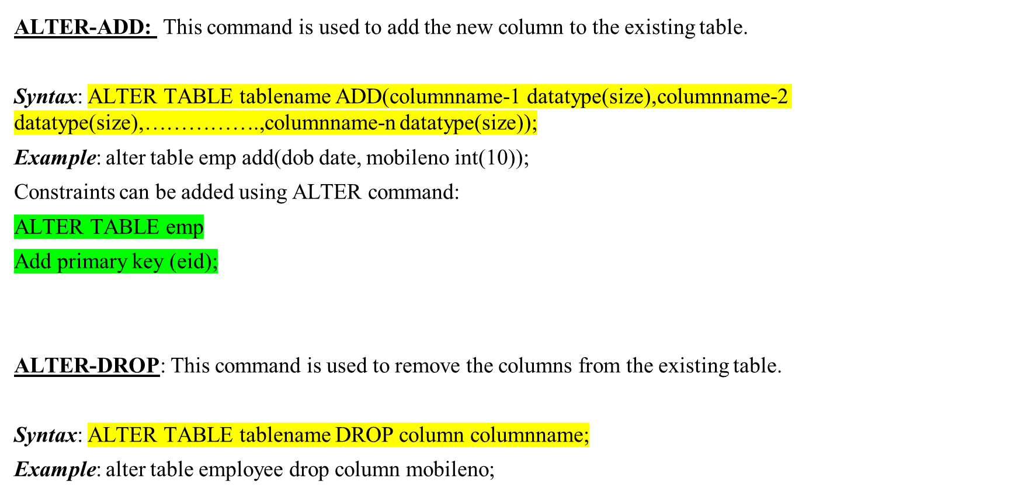
ALTER command
DBMS -UNIT-2

Slide 24
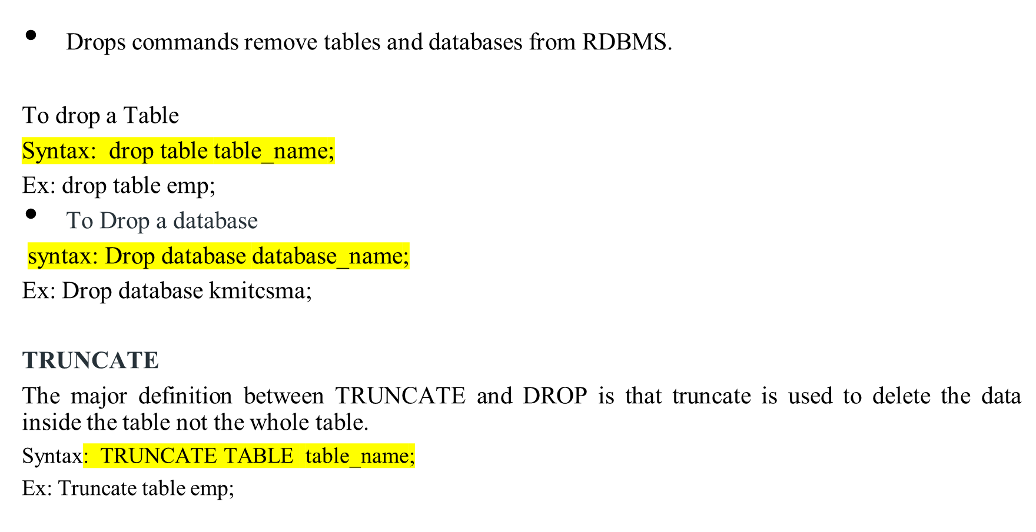
DROP and TRUNCATE
DBMS -UNIT-2

Slide 25
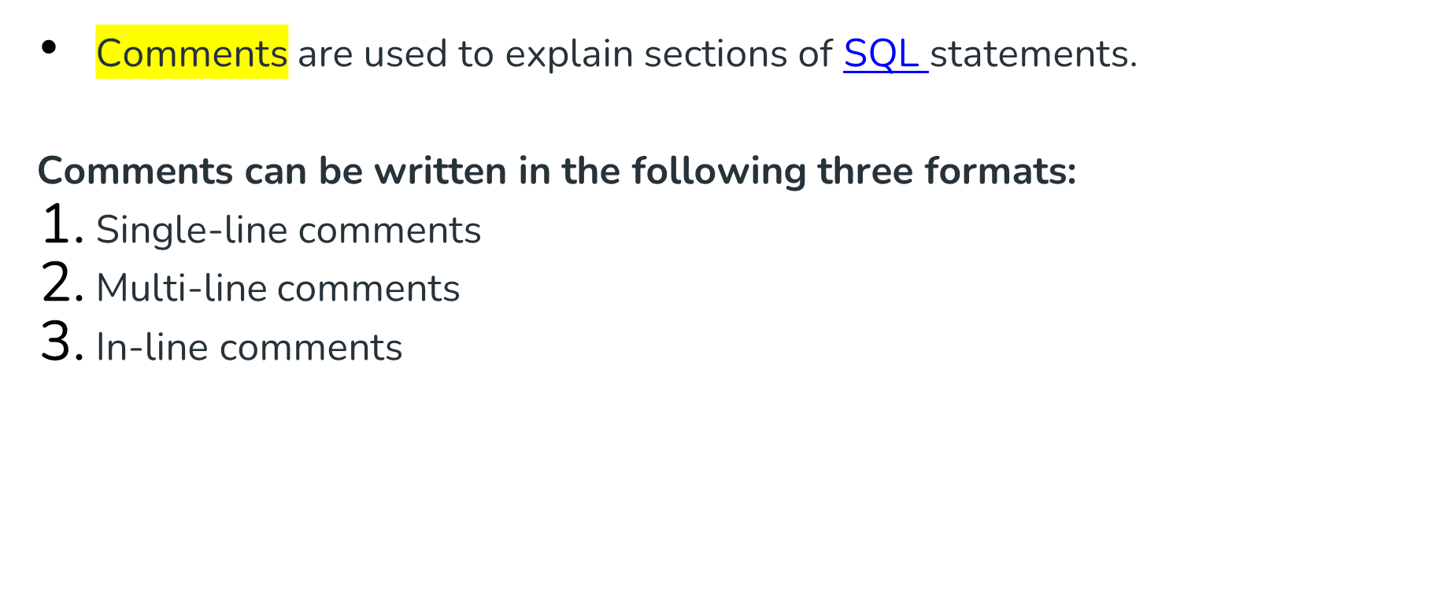
Comments in SQL
DBMS -UNIT-2

Slide 26
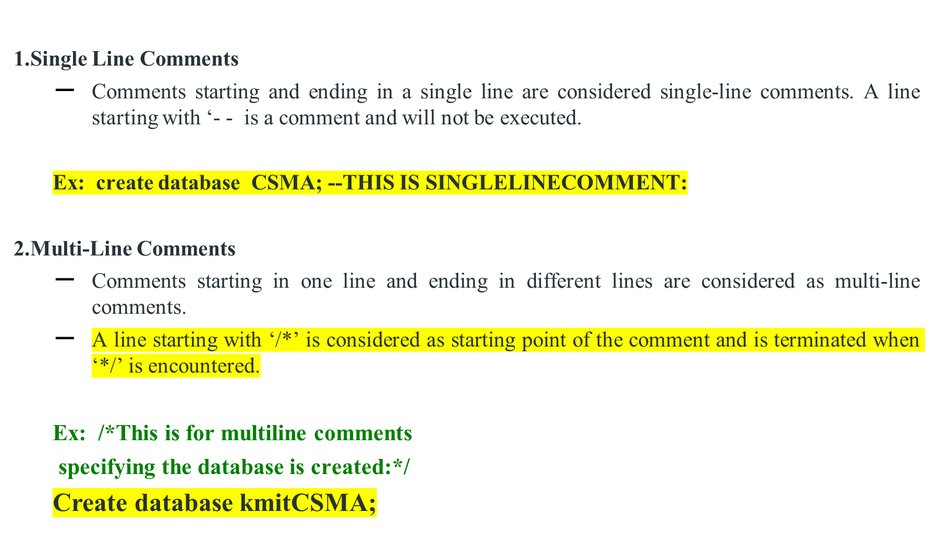
Comments in SQL
DBMS -UNIT-2

Slide 27
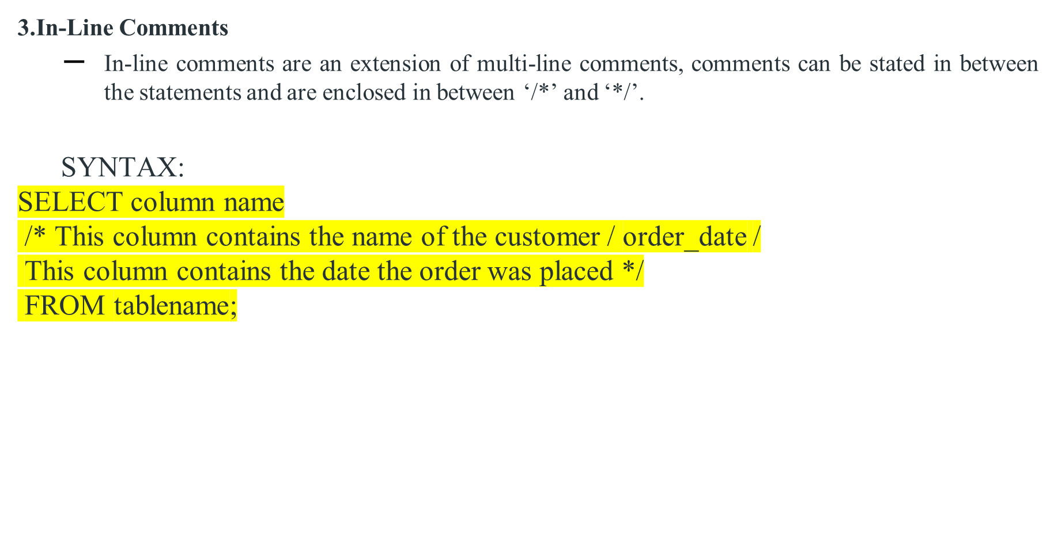
In-line comments
EX: SELECT ename
/* This column contains the name of the customer / order_date /
This column contains the date the order was placed */
FROM emp;
DBMS -UNIT-2

Slide 28
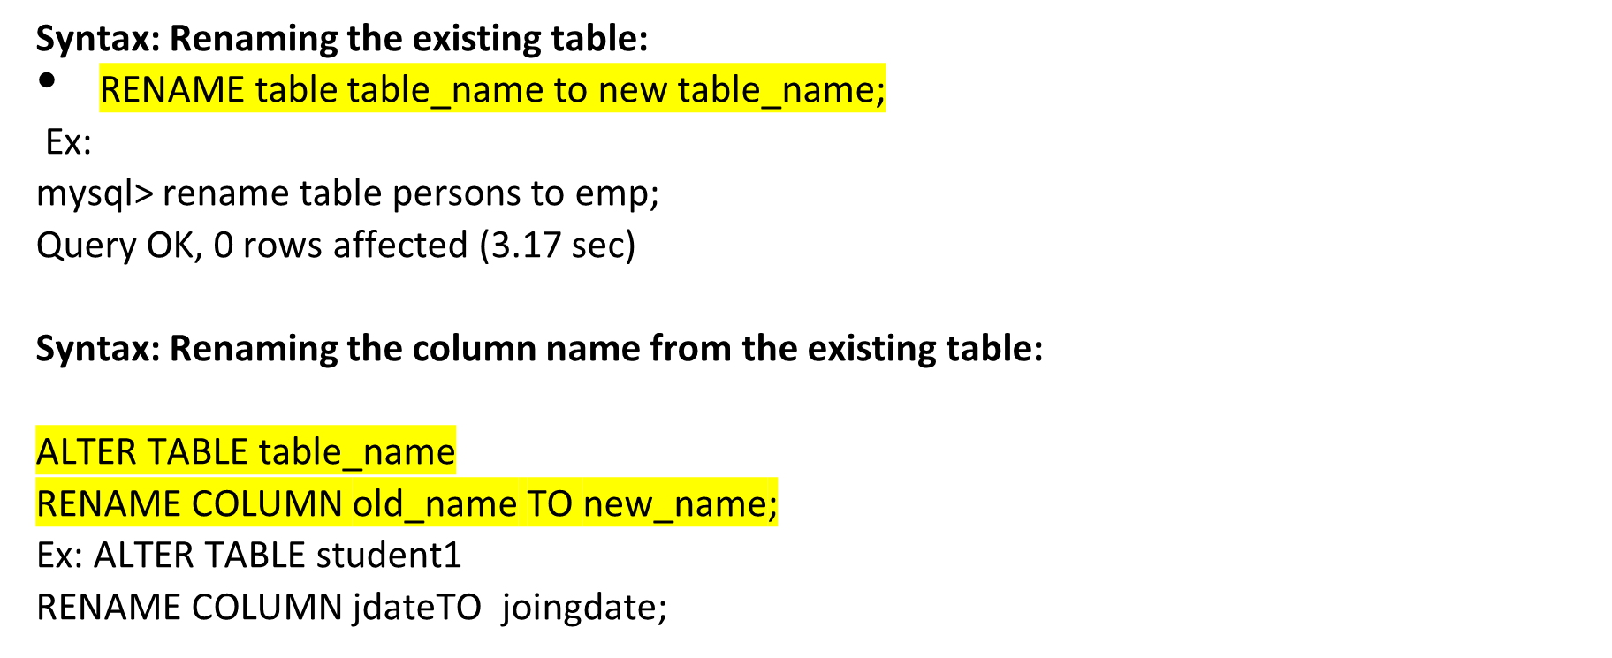
RENAME table and Column name
DBMS -UNIT-2

Slide 29
DML( Data Manipulation Language )
DML stands for Data Manipulation Language. The schema (Table) created by DDL (Data Definition Language) is populated or filled using Data Manipulation Language.
DDL fill the rows of the table, and each row is called Tuple.
Using DML, you can insert, modify, delete and retrieve the information from the Table.
DBMS -UNIT-2

Slide 30
DML( Data Manipulation Language )
DML is short name of Data Manipulation Language which deals with data manipulation and includes most common SQL statements such SELECT, INSERT, UPDATE, DELETE, etc., and it is used to store, modify, retrieve, delete and update data in a database.
INSERT - insert data into a table
SELECT - retrieve data from a database or database objects
UPDATE - updates existing data within a table
DELETE - Delete all records from a database table
DBMS -UNIT-2

Slide 31
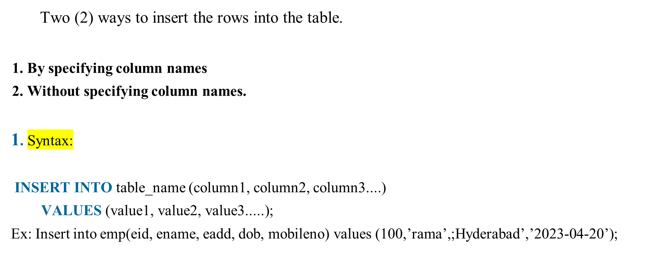
Inserting the tuples/records into the table.
DBMS -UNIT-2

Slide 32
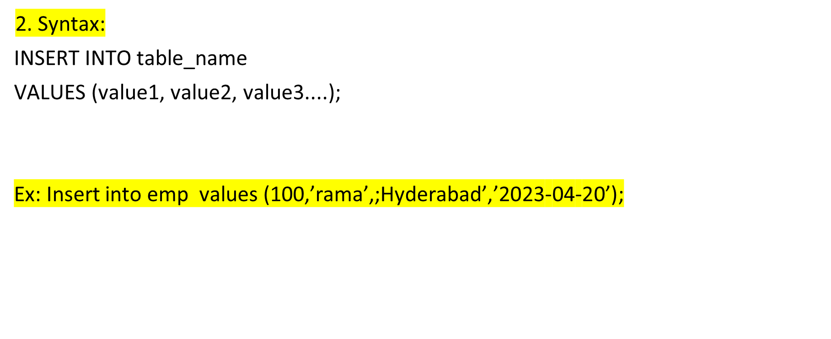
Inserting data into table Without specifying column names
DBMS -UNIT-2

Slide 33
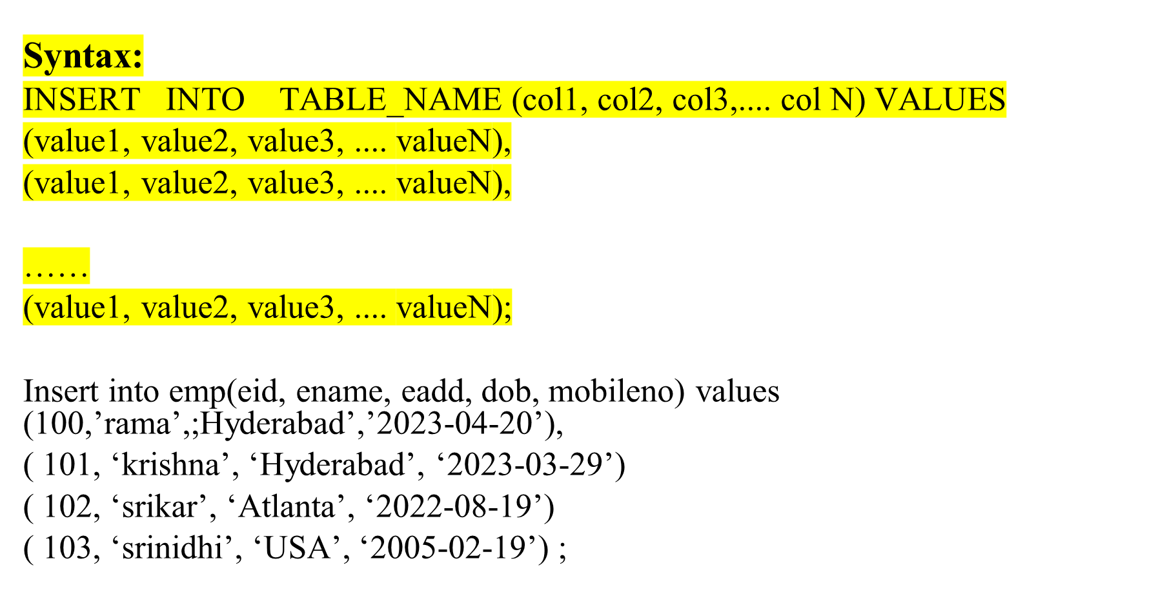
Inserting multiple rows into the table.
DBMS -UNIT-2

Slide 34
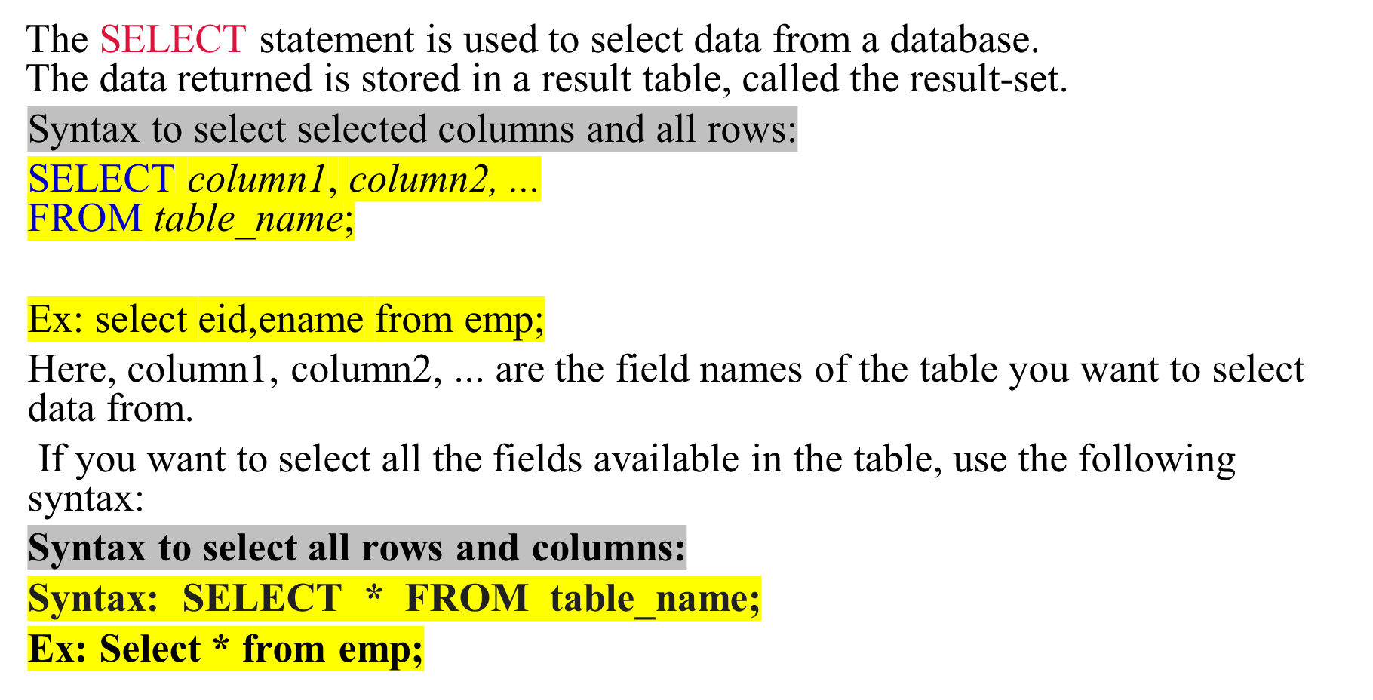
Select command
DBMS -UNIT-2

Slide 35
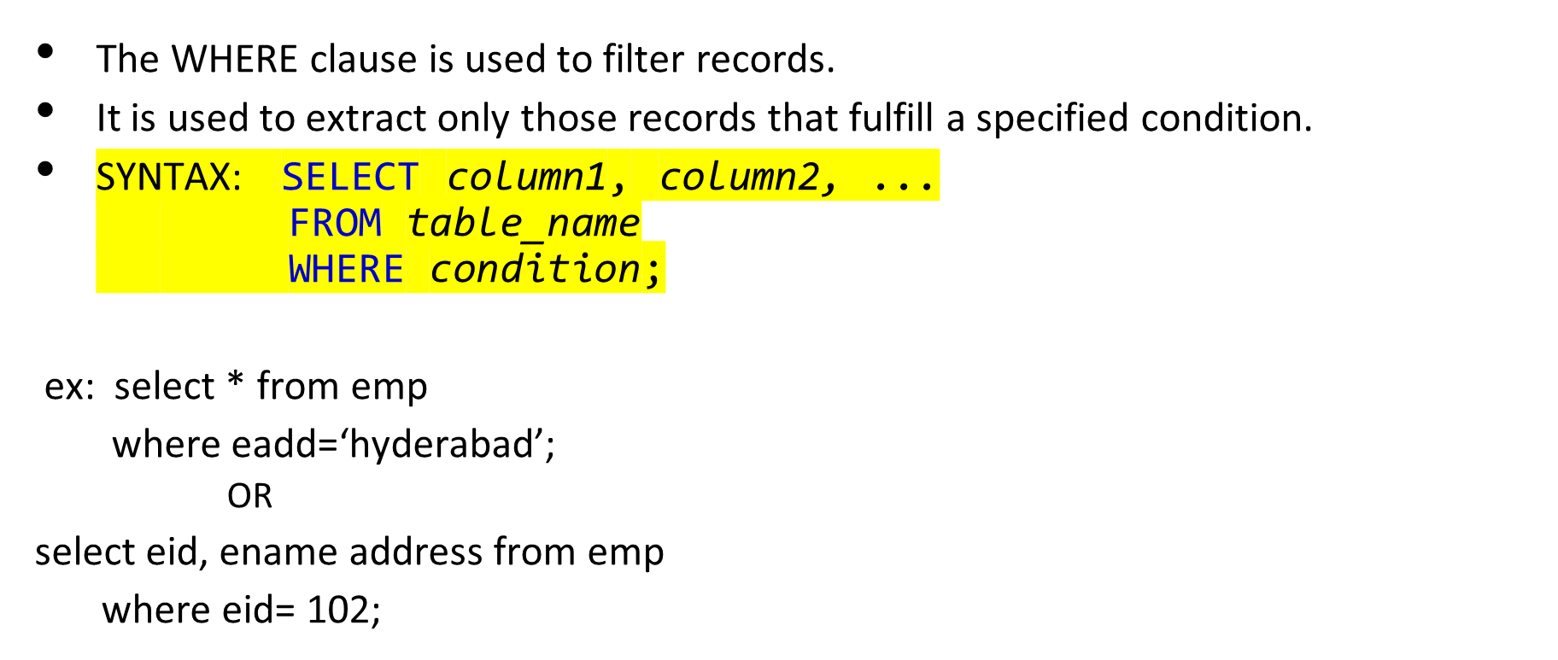
The SQL WHERE Clause
DBMS -UNIT-2

Slide 36
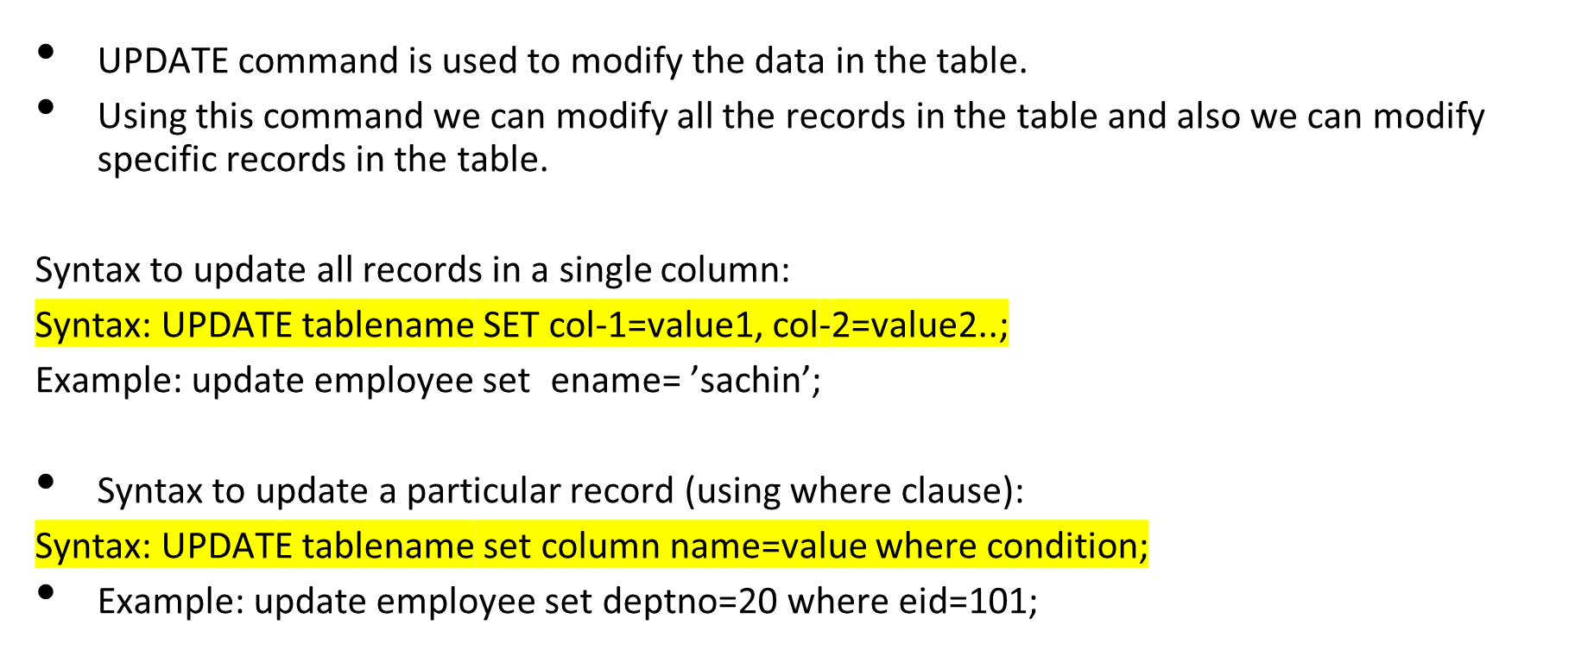
UPDATE command
DBMS -UNIT-2

Slide 37
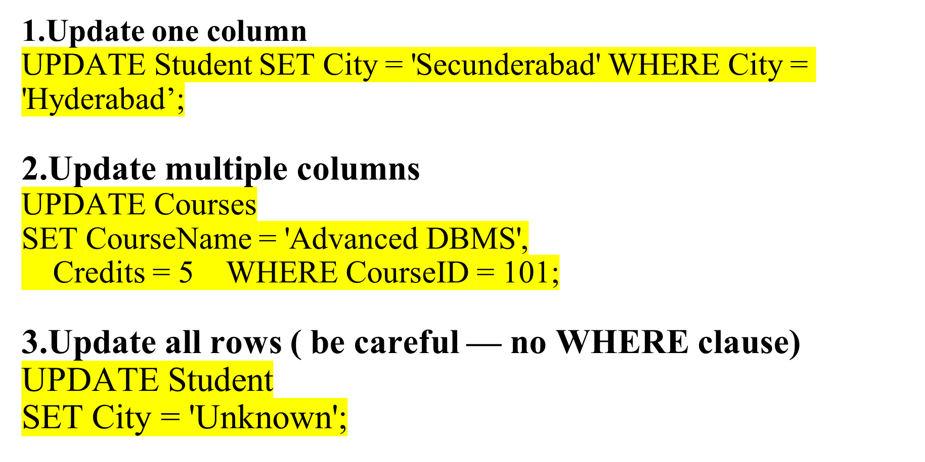
DBMS -UNIT-2

Slide 38
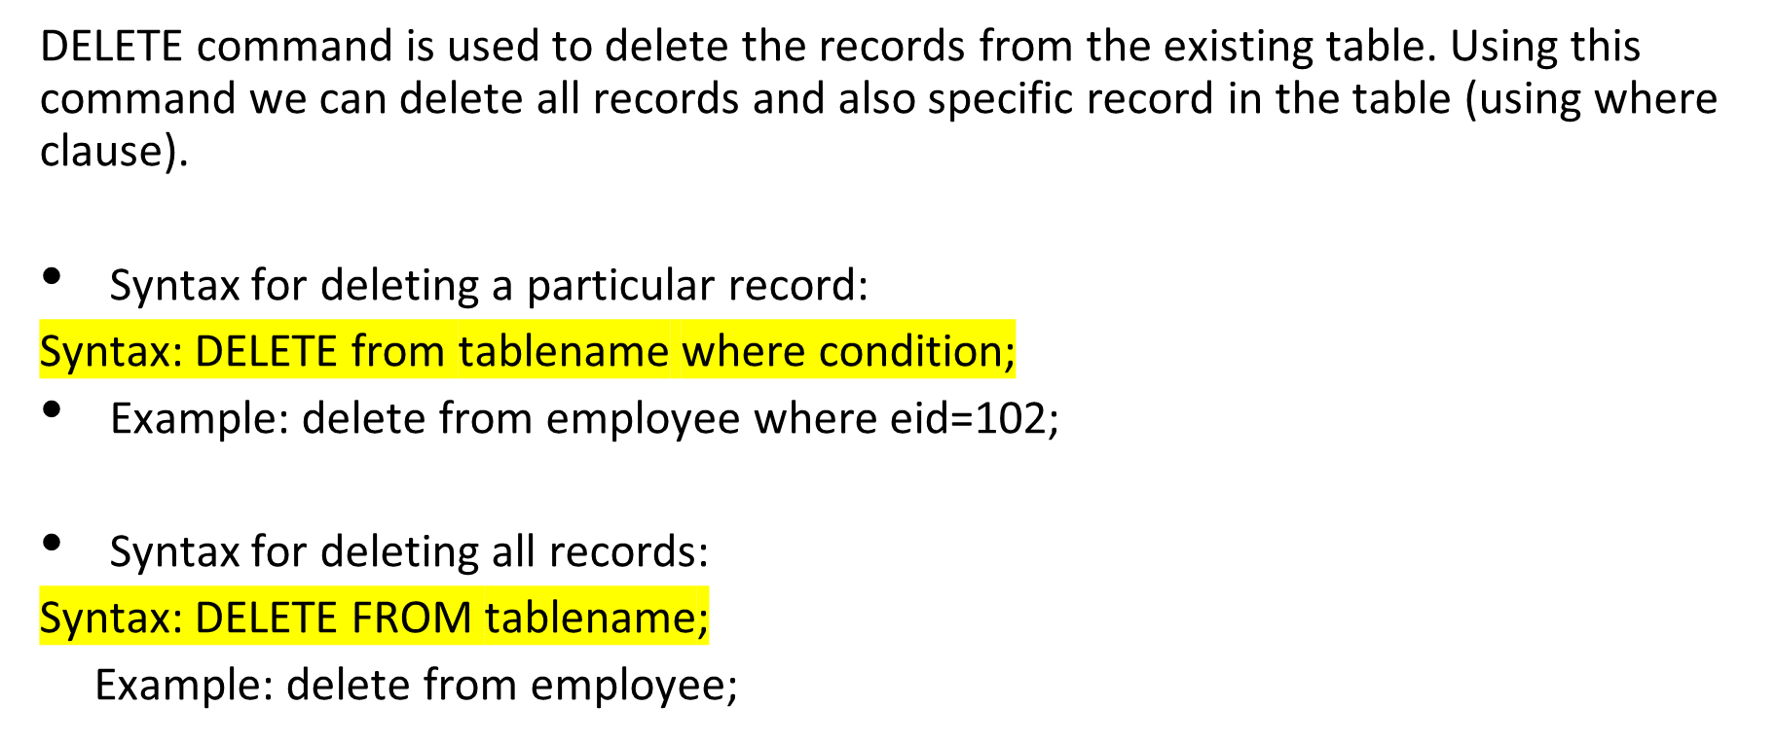
DELETE command
DBMS -UNIT-2

Slide 39
Create Table Using Another Table
A copy of an existing table can also be created using CREATE TABLE.
The new table gets the same column definitions. All columns or specific columns can be selected.
If you create a new table using an existing table, the new table will be filled with the existing values from the old table.
Syntax
CREATE TABLE new_table_name AS SELECT column1, column2,...
FROM existing_table_name
WHERE ....;
Example
CREATE TABLE TestTable AS
SELECT customername, contactname
FROM customers;
DBMS -UNIT-2

Slide 40
INTRODUCTION TO THE RELATIONAL MODEL
What is Relational Model?
Relational model can be represented as a table with columns and rows. Each row is known as a tuple. Each table of the column has a name or attribute.
Relational Model (RM) represents the database as a collection of relations. A relation is nothing but a table of values. Every row in the table represents a collection of related data values. These rows in the table denote a real-world entity or relationship.

Slide 41
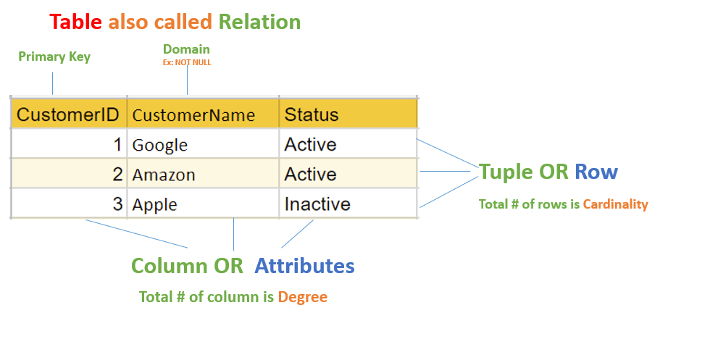

Slide 42
Relational Model Concepts
Attribute: Each column in a Table. Attributes are the properties which define a relation. e.g., Student_Rollno, NAME,etc.
Tables – In the Relational model the relations are saved in the table format. It is stored along with its entities. A table has two properties rows and columns. Rows represent records and columns represent attributes.
Tuple – It is nothing but a single row of a table, which contains a single record.
Relation Schema: A relation schema represents the name of the relation with its attributes.
Degree (Arity): The total number of attributes which in the relation is called the degree of the relation.

Slide 43
Cardinality: Total number of rows present in the Table.
Column: The column represents the set of values for a specific attribute.
Relation instance – Relation instance is a finite set of tuples in the RDBMS system. Relation instances never have duplicate tuples.
Relation key - Every row has one, two or multiple attributes, which is called relation key.
Attribute domain – Every attribute has some pre-defined value and scope which is known as attribute domain.

Slide 44
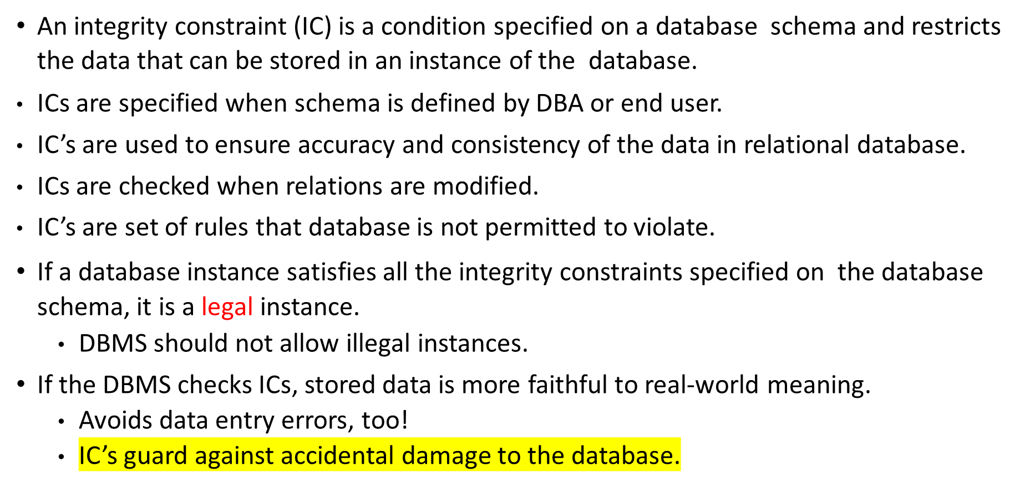
INTEGRITY CONSTRAINTS OVER RELATIONS
DBMS -UNIT-2

Slide 45
Types of integrity constraints
Domain Integrity
Entity Integrity Constraint
Referential Integrity Constraint
Key Constraints
DBMS -UNIT-2

Slide 46
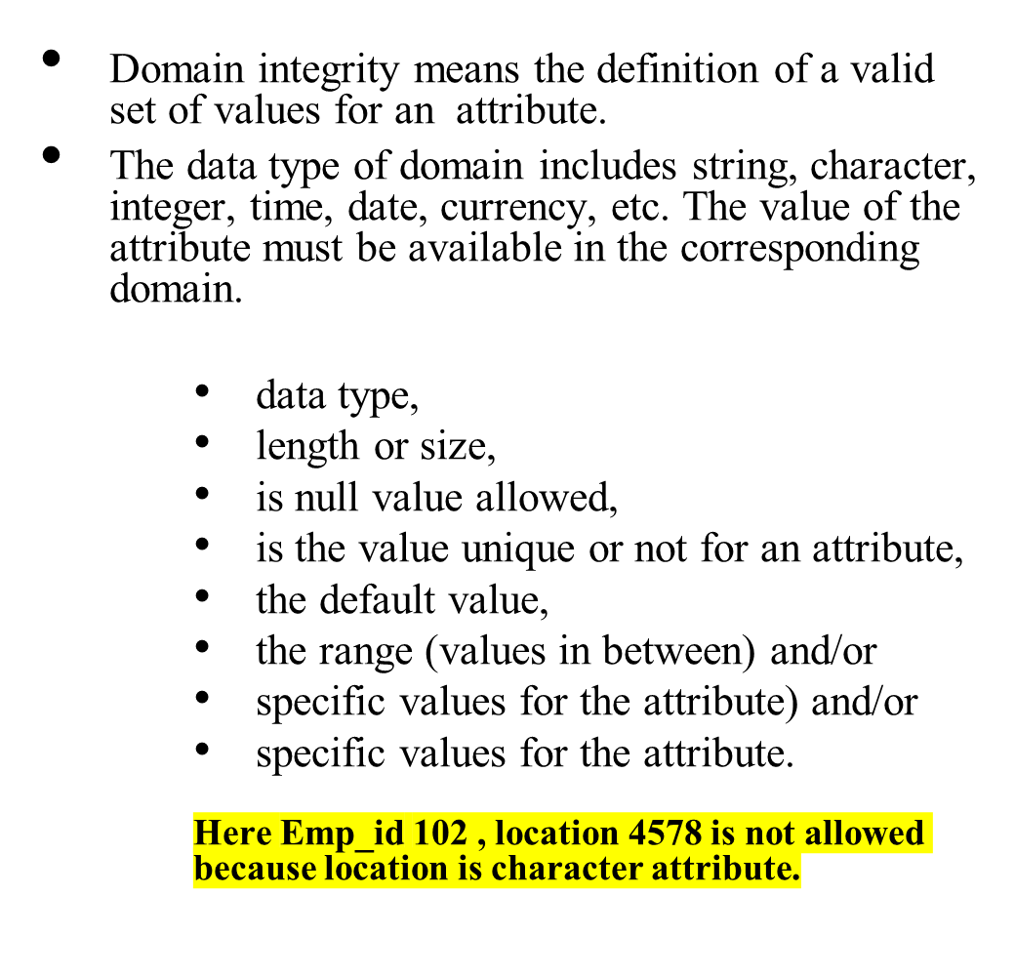
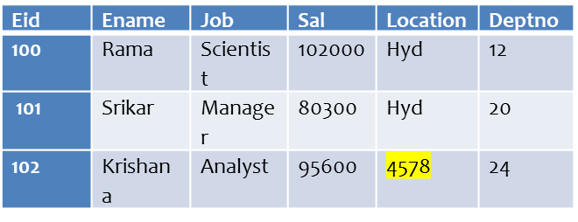
Domain Integrity
Domain Constraints are user-defined columns that help the user to enter the value according to the data type.
And if it encounters a wrong input it gives the message to the user that the column is not fulfilled properly.
Or in other words, it is an attribute that specifies all the possible values that the attribute can hold like integer, character, date, time, string, etc.
It defines the domain or the set of values for an attribute and ensures that the value taken by the attribute must be an atomic value(Can’t be divided) from its domain.
DBMS -UNIT-2

Slide 47
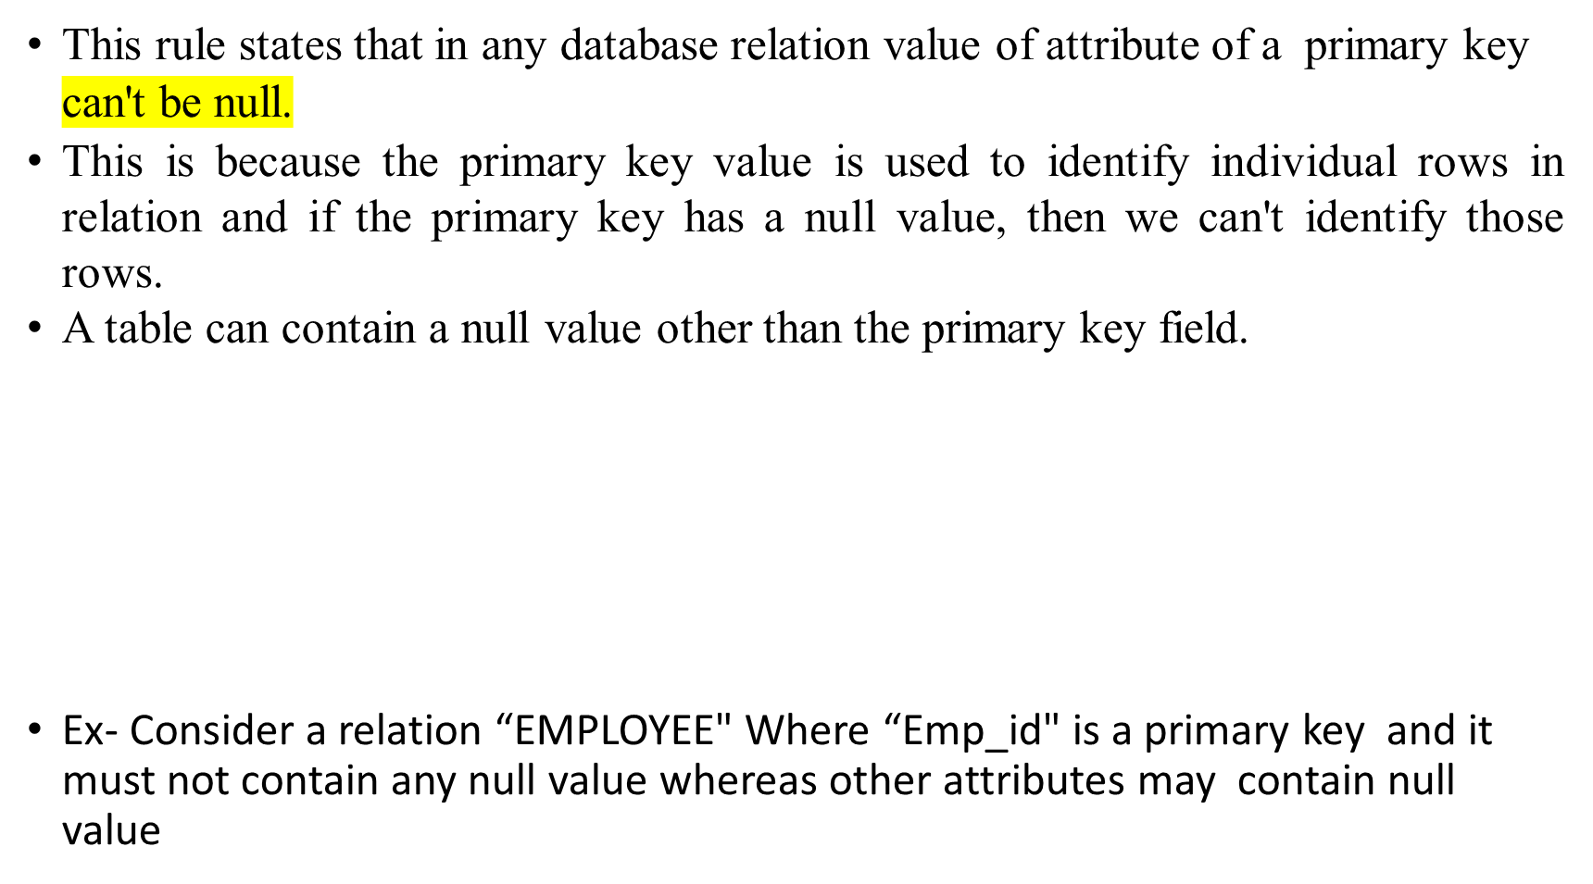
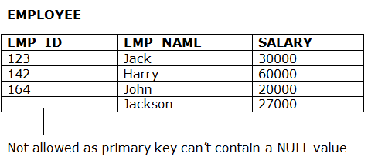
Entity Integrity Constraint-
DBMS -UNIT-2

Slide 48
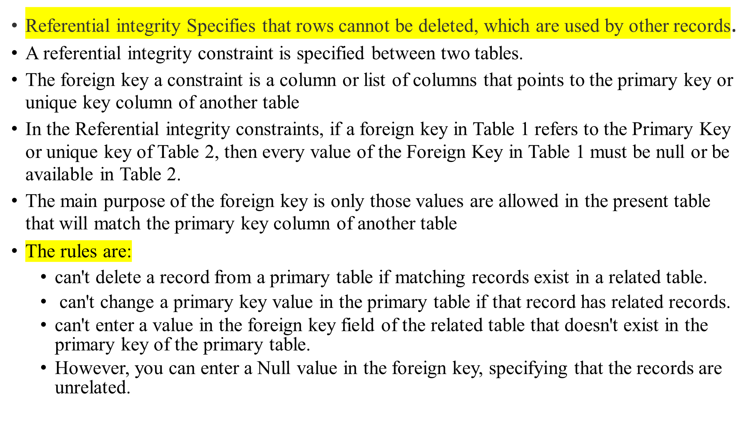
Referential Integrity Constraint
DBMS -UNIT-2

Slide 49
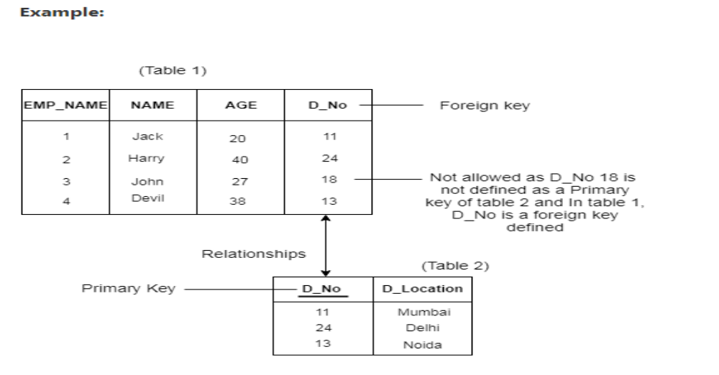

Referential Integrity Constraint-Example:
EMP- CHILD TABLE
DEPT--- PARENT TABLE
DBMS -UNIT-2

Slide 50
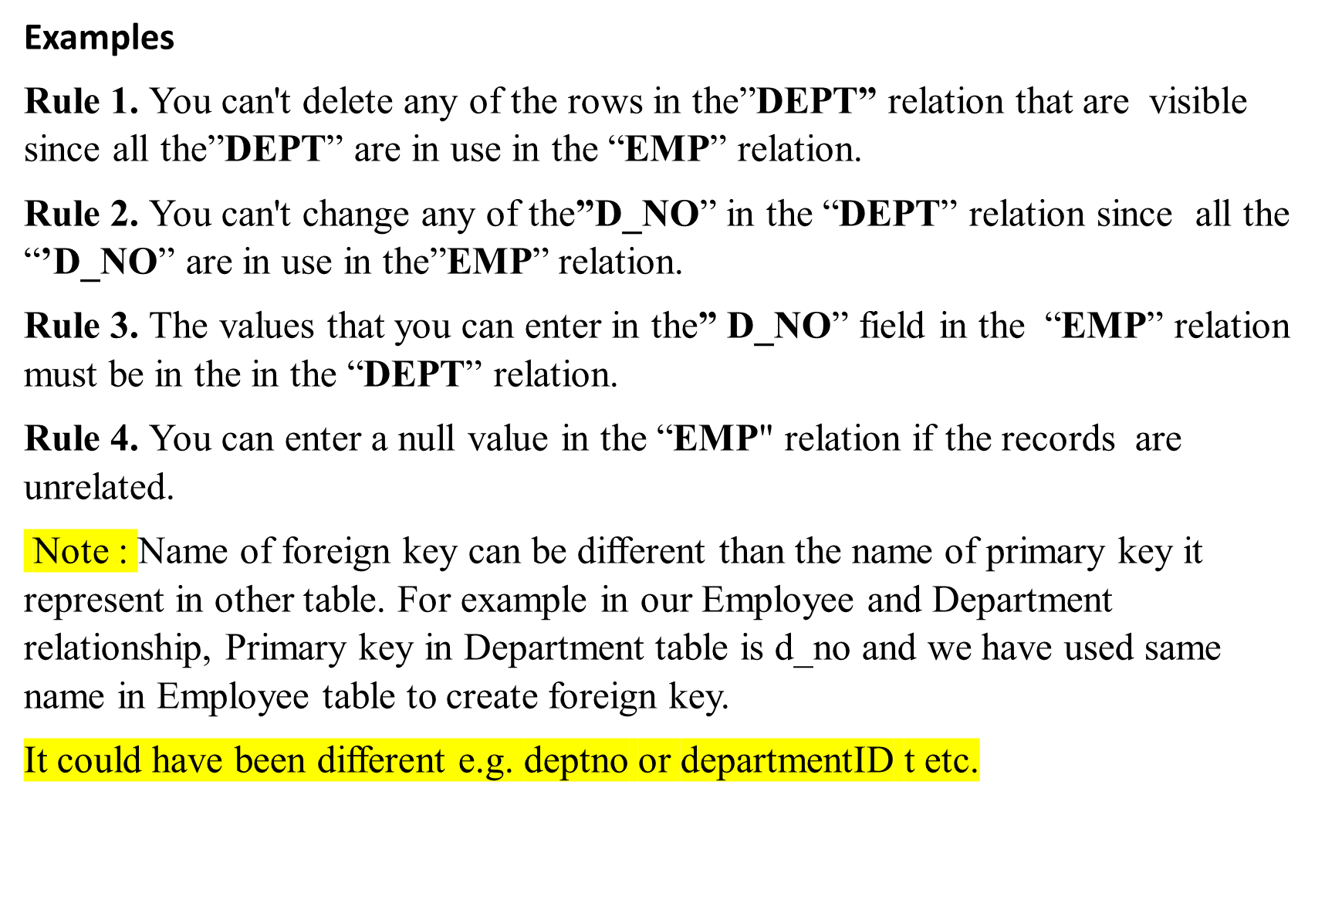
DBMS -UNIT-2

Slide 51
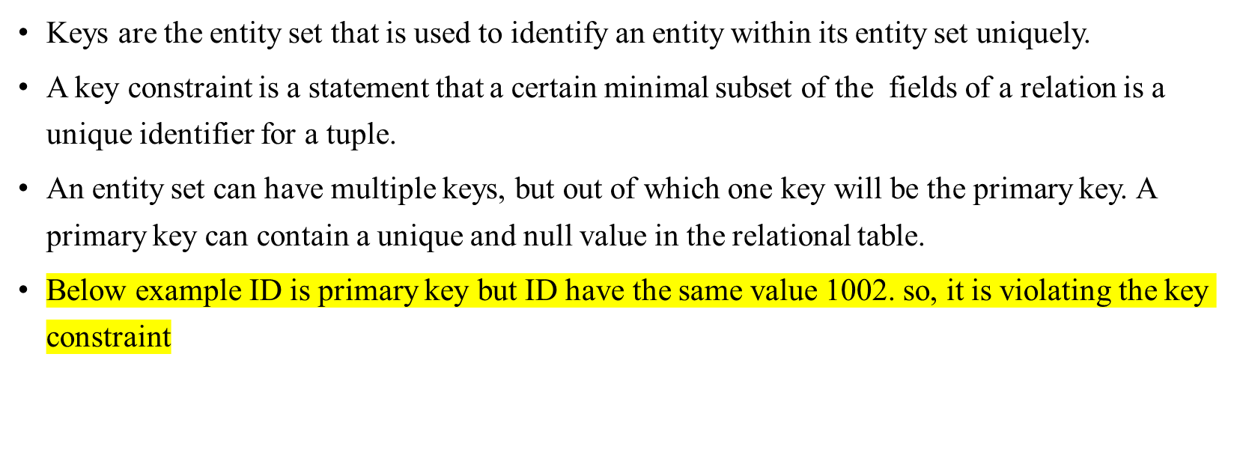
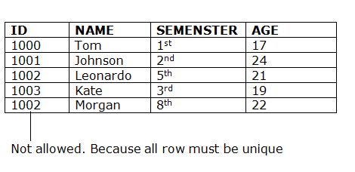
Key Constraints
DBMS -UNIT-2

Slide 52
Other Types of Constraints
SQL Constraints are the rules applied to a data columns or the complete table to limit the type of data that can go into a table. When you try to perform any INSERT, UPDATE, or DELETE operation on the table, RDBMS will check whether that data violates any existing constraints
    NOT NULL constraint
    NULL constraint
    PRIMARY KEY constraint
    FOREIGN KEY constraint
    UNIQUE constraint
    CHECK constraint
    DEFAULT Constraint
    AUTO_INCREMENT

Slide 53
NOT NULL Constraint
The NOT NULL constraint in SQL is used to ensure that a column in a table doesn't contain NULL (empty) values, and prevent any attempts to insert or update rows with NULL values.
NOT NULL Ensures that a column cannot have a NULL value.
The NOT NULL constraint enforces a column to NOT accept NULL values, which means that you cannot insert a new record, or update a record without adding a value to this field.
NULL represents a record where data may be missing data or data for that record may be optional
Once not null is applied to a particular column, you cannot enter null values to that column and restricted to maintain only some proper value other than null
A not-null constraint cannot be applied at table level
DBMS -UNIT-2

Slide 54
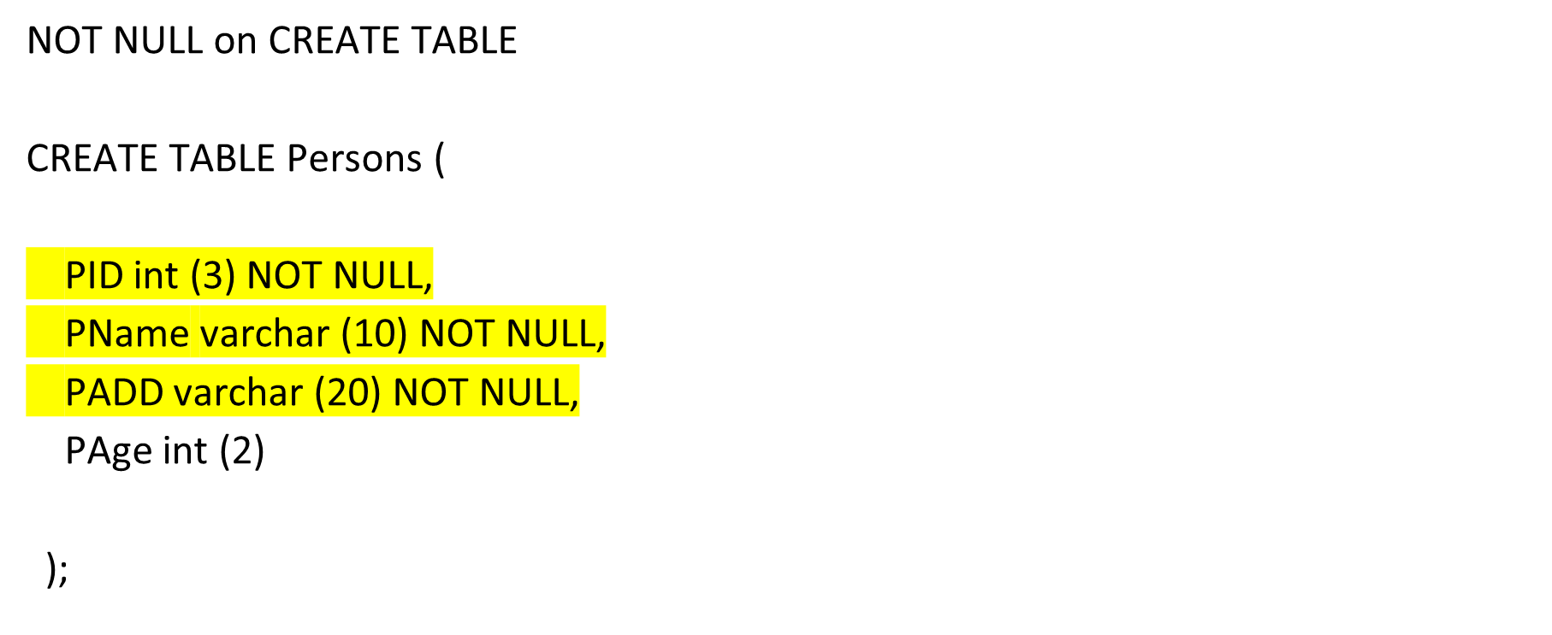
NOT NULL Constraint
DBMS -UNIT-2

Slide 55
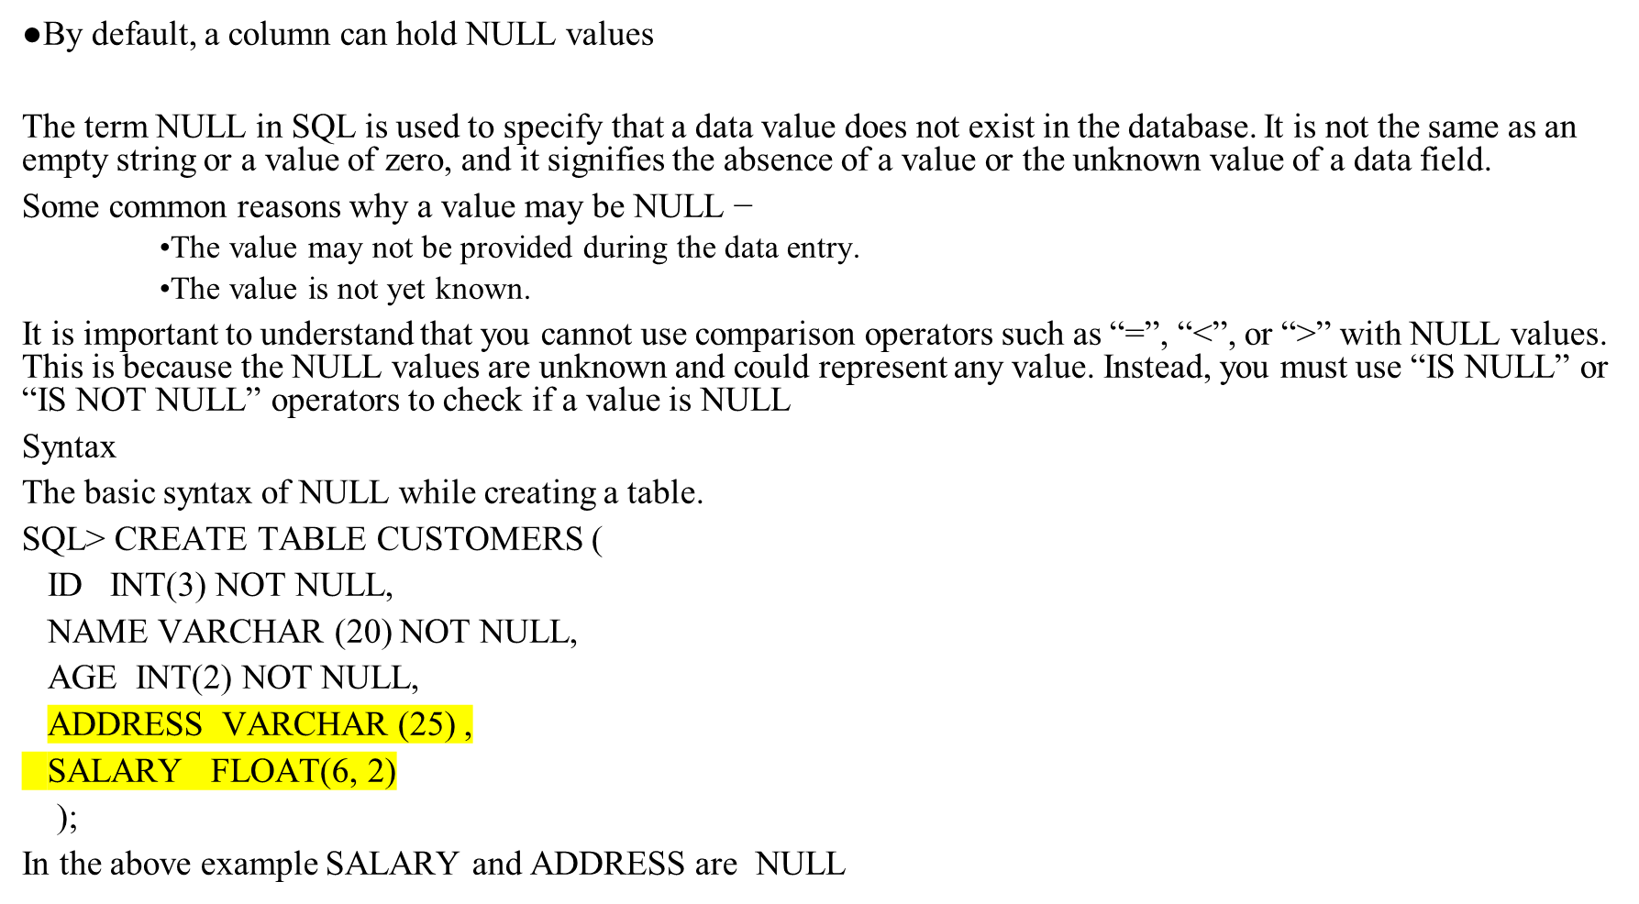
NULL Constraint
DBMS -UNIT-2

Slide 56
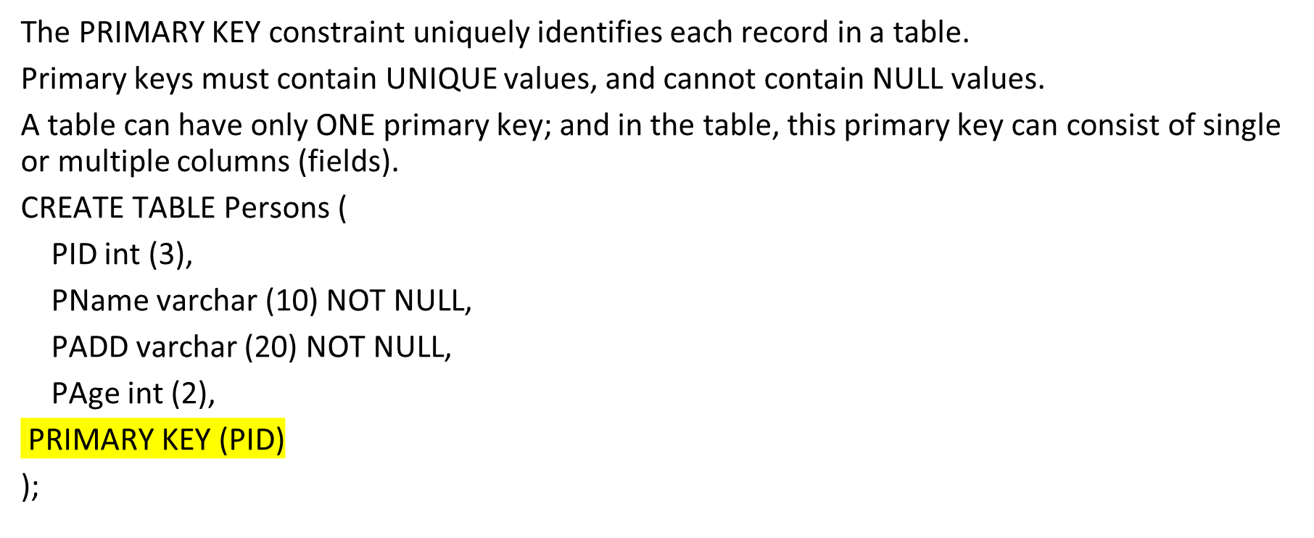
PRIMARY KEY constraint
DBMS -UNIT-2

Slide 57
FOREIGN KEY Constraint
The FOREIGN KEY constraint is used to prevent actions that would destroy links between tables.
A FOREIGN KEY is a field (or collection of fields) in one table, that refers to the PRIMARY KEY or UNIQUE column in another table.
The table with the foreign key is called the child table, and the table with the primary key is called the referenced or parent table.
DBMS -UNIT-2

Slide 58
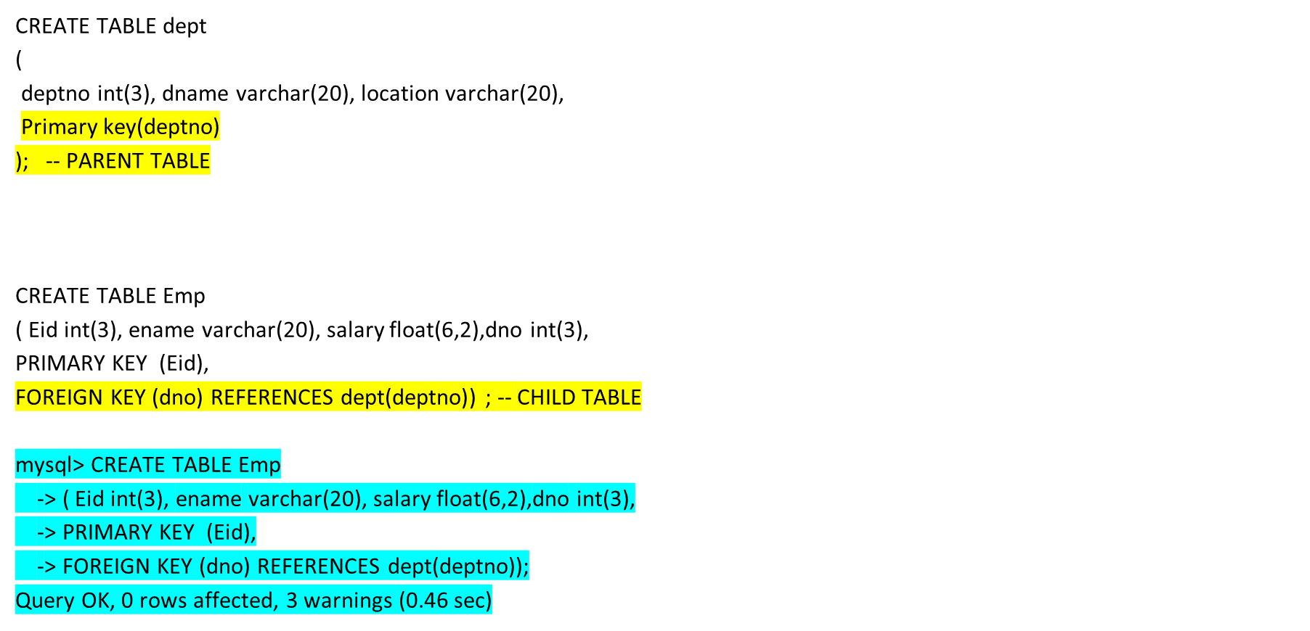
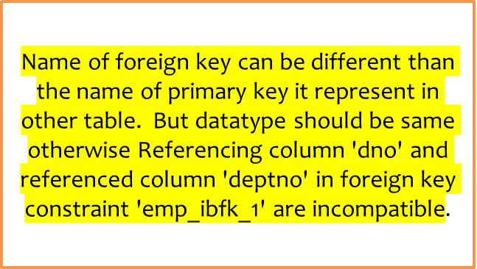
FOREIGN KEY Constraint
DBMS -UNIT-2

Slide 59
Difference between Primary key and Foreign key in SQL
Here is some important difference between primary and foreign keys in a table which is worth remembering both on SQL interview point of view and knowledge point of view.
1) Name of foreign key can be different than the name of primary key it represent in other table. For example in our Employee and Department relationship, Primary key in Department table is dept_id and we have used same name in Employee table to create foreign key. It could have been different e.g. departmentId or departmentID t etc.
2) Another difference between primary and foreign key is that unlike primary key, a foreign key can be null e.g. in our example you can have an Employee record for which dept_id can be null, this shows that no corresponding record in Department table.
3) One more difference between primary key and foreign key is that foreign key can be duplicate opposite to primary key which is always unique.
4) By using foreign key constraints, we can introduce referential integrity in multiple table relationship in SQL. Referential integrity guarantees data integrity, see benefits of Referential Integrity in SQL to know more.
5) Foreign key mostly works as a link between two table when we join tables using INNER JOIN and OUTER JOIN. For example, when we INNER JOIN both Employee with Department table, we can use dept_id as joining column. See How to join three tables in SQL for more details.
6) Table on which a column is declared as a primary key is known as parent table in the relationship and foreign key table is known as child table in a relationship. For example in Employee and Department relationship, Department is parent table because dept_id is primary key there and Employee is child table because dept_id is a foreign key in this table
DBMS -UNIT-2

Slide 60
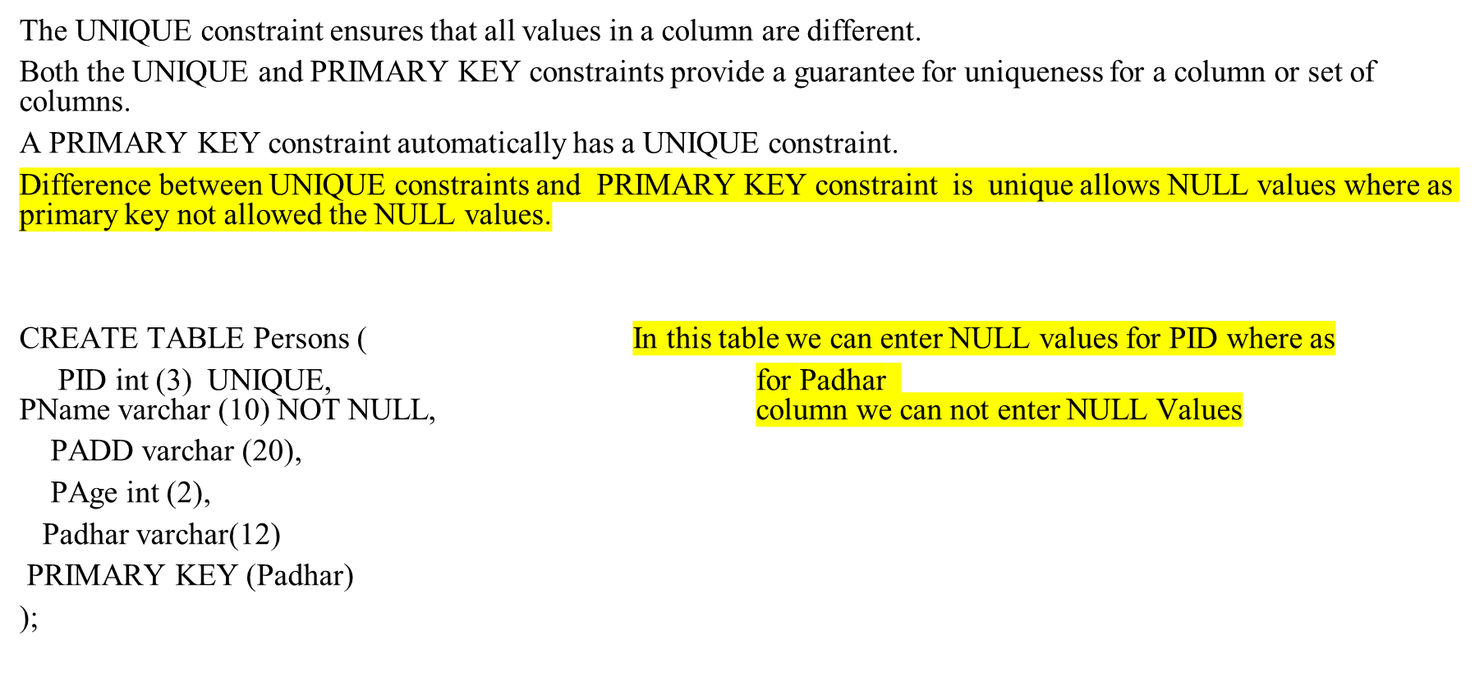
UNIQUE Constraint
DBMS -UNIT-2

Slide 61
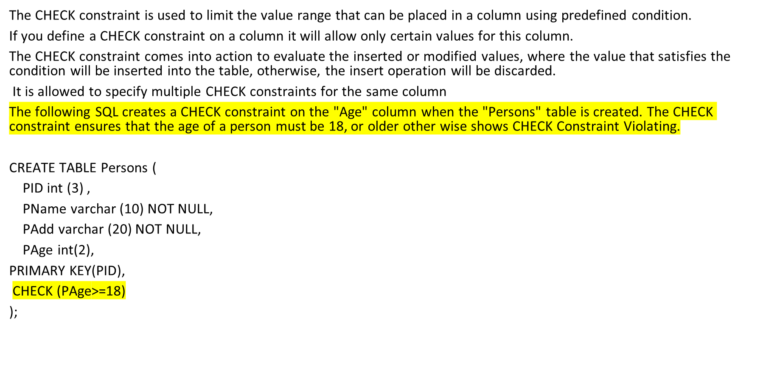
CHECK constraint
DBMS -UNIT-2

Slide 62
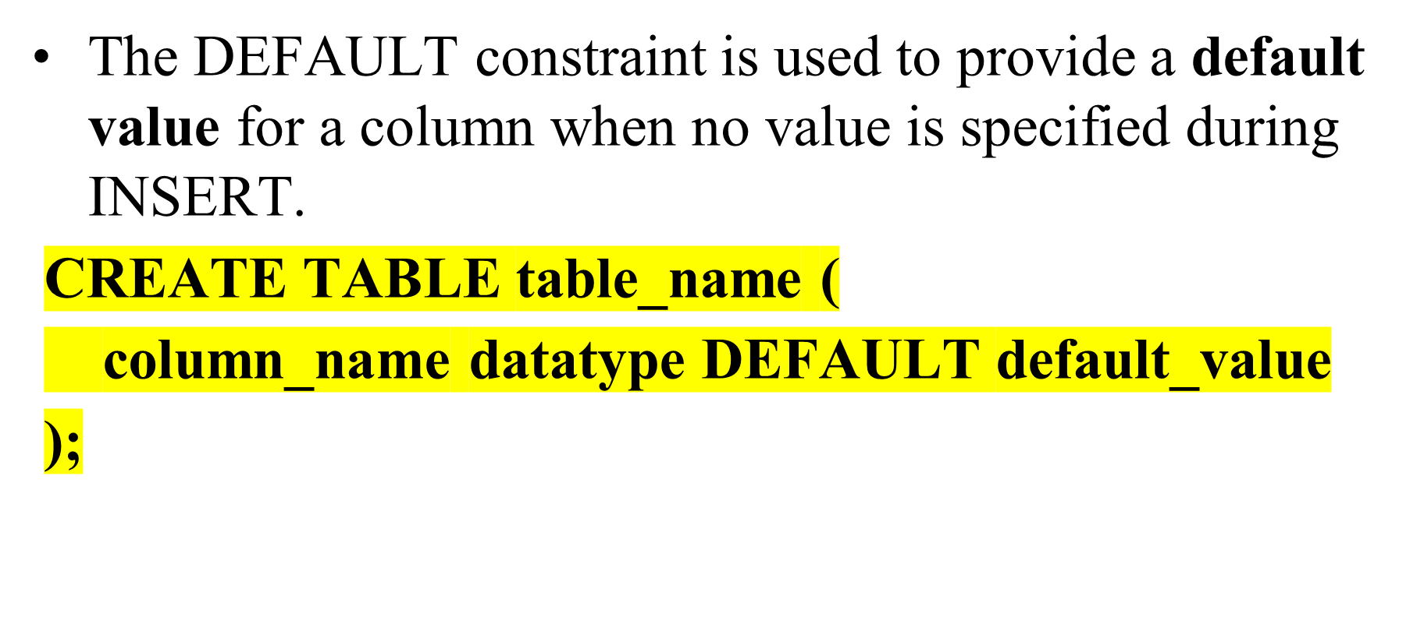
DEFAULT

Slide 63
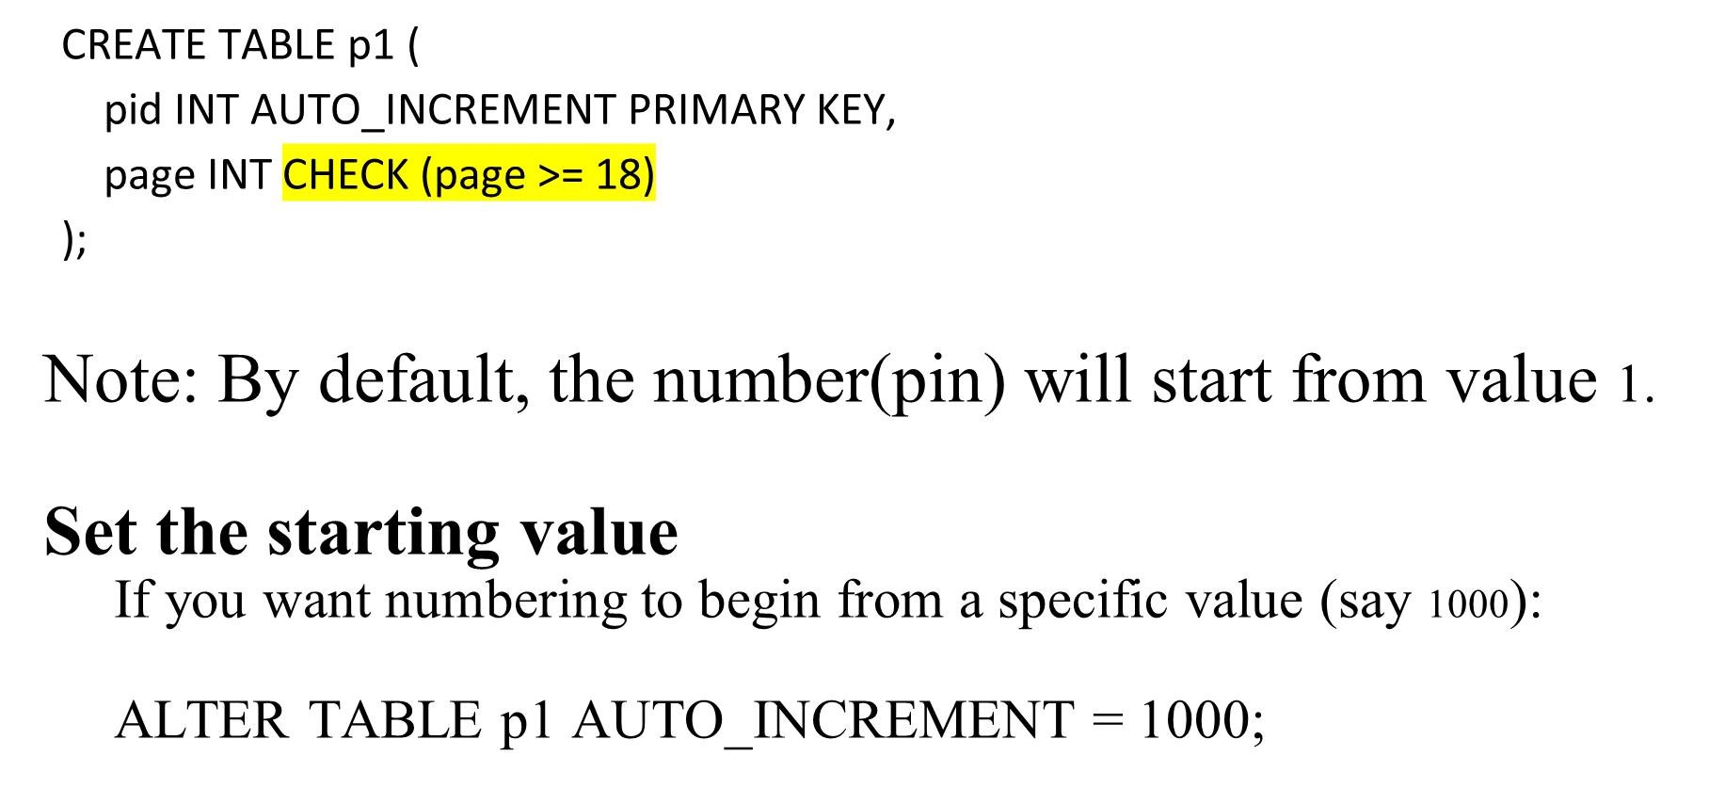
AUTO_INCREMENT

Slide 64
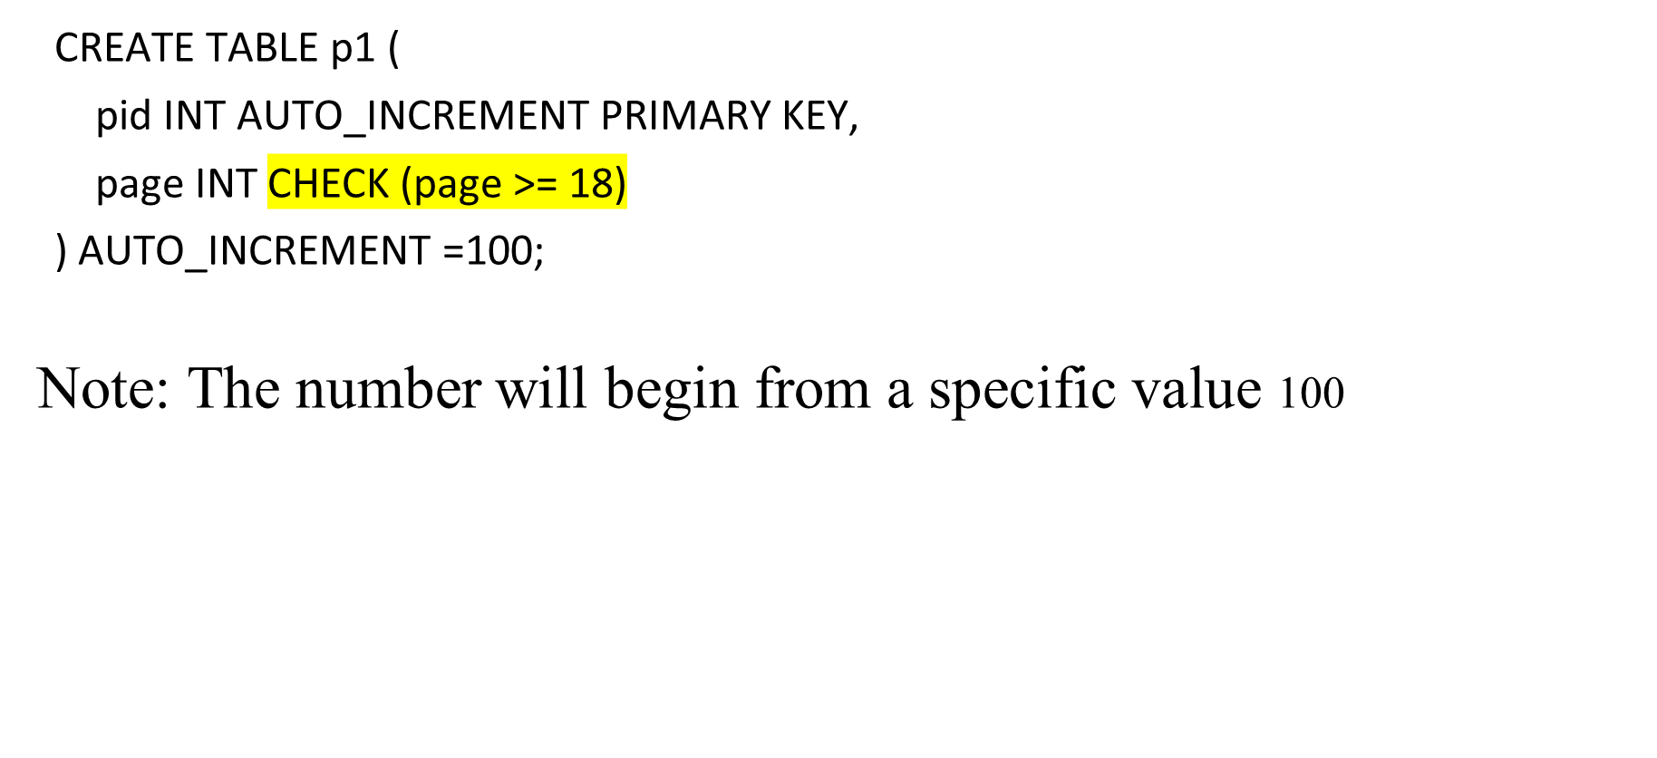
AUTO_INCREMENT

Slide 65
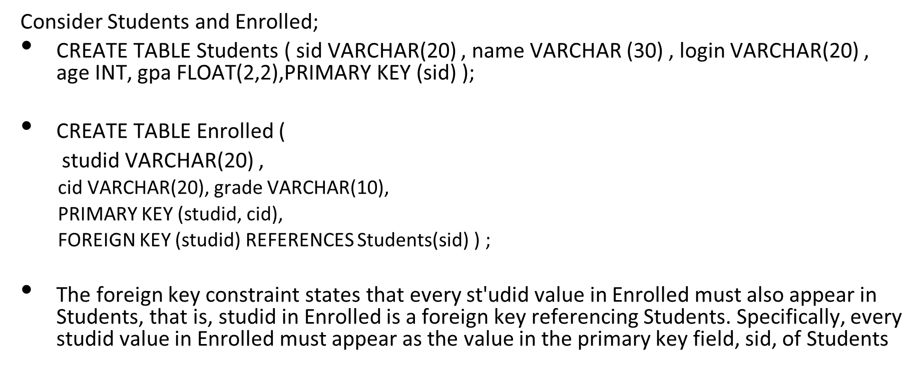
ENFORCING INTEGRITY CONSTRAINTS
DBMS -UNIT-2

Slide 66
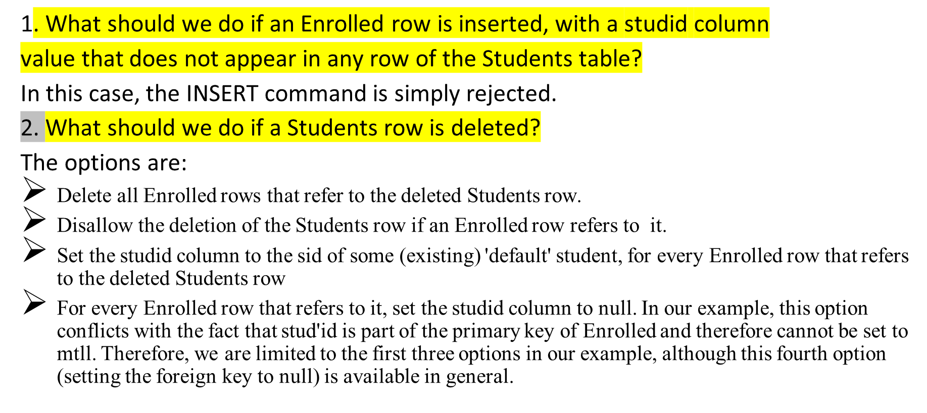
SQL provides several alternative ways to handle foreign key violations. We must consider three basic questions
DBMS -UNIT-2

Slide 67
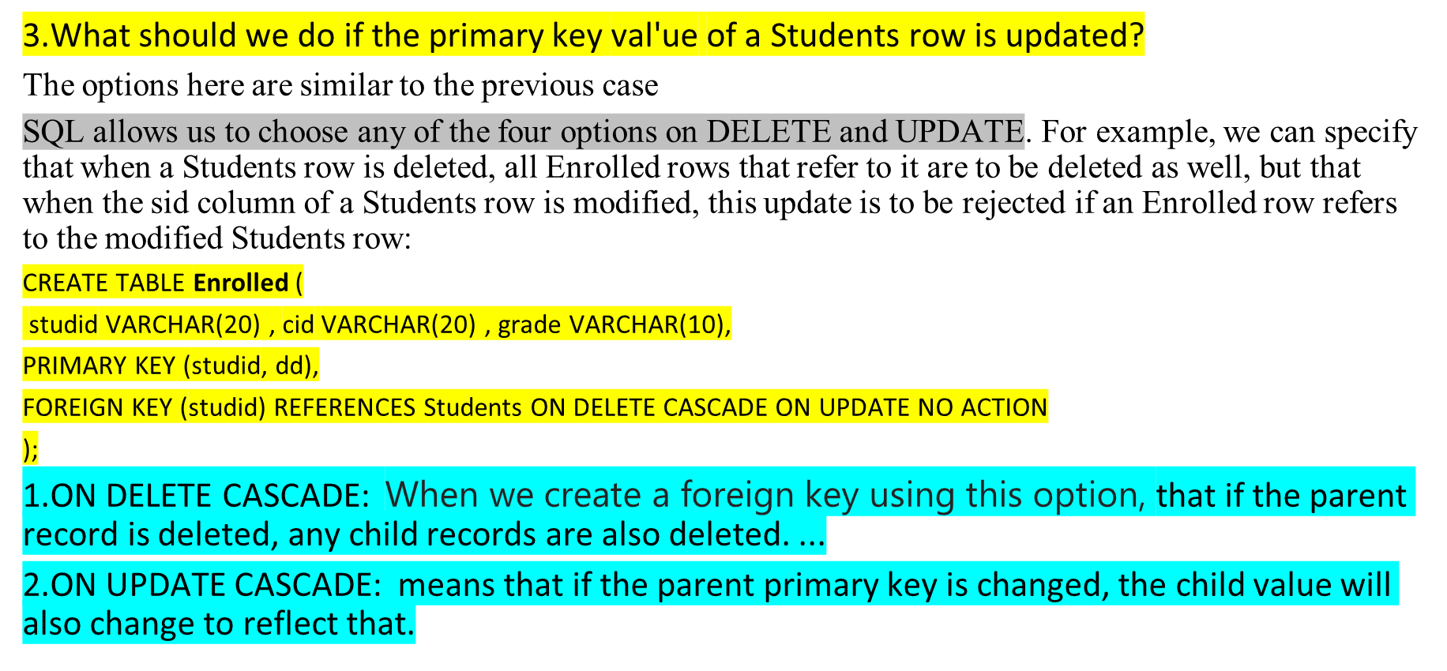
SQL provides several alternative ways to handle foreign key violations. We must consider three basic questions
DBMS -UNIT-2

Slide 68
The default option is NO ACTION, which means that the action (DELETE or UPDATE) is to be rejected.
Thus, the ON UPDATE clause in our example could be omitted, with the same effect.
The CASCADE keyword says that, if a Students row is deleted, all Enrolled rows that refer to it are to be deleted as well.
If the UPDATE clause specified CASCADE, and the sid column of a Students row is updated, this update is also carried out in each Enrolled row that refers to the updated Students row.
If a Students row is deleted, we can switch the enrollment to a 'default' student by using ON DELETE SET DEFAULT.
It is really not appropriate to switch enrollments to a default student.
The correct solution in this example is to also delete all enrollment tuples for the deleted student (that is, CASCADE) or to reject the update.
SQL also allows the use of null as the default value by specifying ON DELETE SET NULL.
DBMS -UNIT-2

Slide 69
Transactions and Constraints
A program that runs against a database is called a transaction, and it can contain several statements (queries, inserts, updates, etc.) that access the database.
If (the execution of) a statement in a transaction violates an integrity constraint, should the DBMS detect this right away or should all constraints be checked together just before the transaction completes?
By default, a constraint is checked at the end of every SQL statement that could lead to a violation, and if there is a violation, the statement is rejected.
Sometimes this approach is too inflexible.
Consider the following variants of the Students and Courses relations; every student is required to have an honors course, and every course is required to have a grader, who is some student.
DBMS -UNIT-2

Slide 70
  CREATE TABLE Students (
  sid VARCHAR(20) ,
  name VARCHAR(30),
  login VARCHAR (20) ,
  age INT,
  honors VARCHAR(10) NOT NULL,
  gpa FLOAT(2,2) PRIMARY KEY (sid),
  FOREIGN KEY (honors) REFERENCES Courses (cid)
  );
  CREATE TABLE Courses (
  cid VARCHAR(10),
  cname VARCHAR ( 10) ,
  credits INT,
  grader VARCHAR(20) NOT NULL,
  PRIMARY KEY (cid)
  FOREIGN KEY (grader) REFERENCES Students (sid)
  );
DBMS -UNIT-2

Slide 71
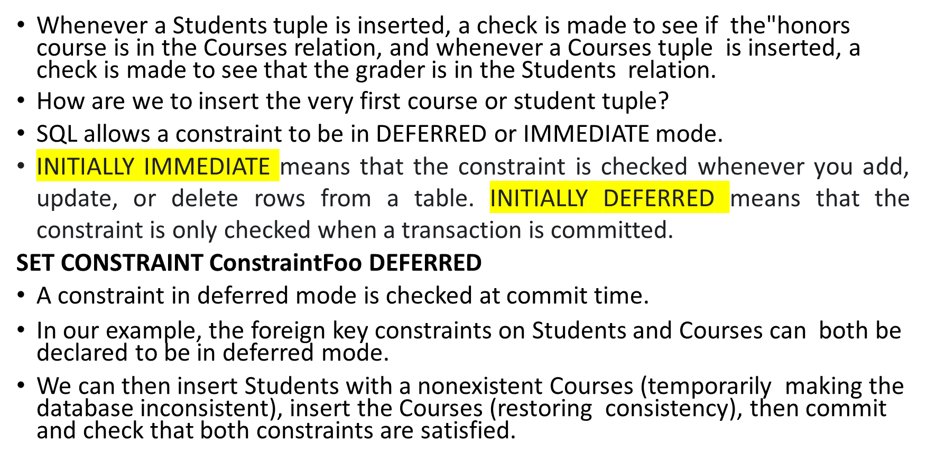
DBMS -UNIT-2

Slide 72
QUERYING RELATIONAL DATA
DBMS -UNIT-2

Slide 73
QUERYING RELATIONAL DATA
Relational data means information stored in tables with relationships (via primary keys, foreign keys, and constraints).
Querying is done using SQL (Structured Query Language).
A relational database query (query, for short) is a question about the data and the answer consists of a new relation containing the result.
Basic Query Structure:
SELECT column1, column2, ...
FROM table_name
WHERE condition
GROUP BY column
HAVING group_condition
ORDER BY column [ASC|DESC]
LIMIT n;
DBMS -UNIT-2

Slide 74
QUERYING RELATIONAL DATA
sid | name | login | age | gpa
53666 | Jones | jones@cs | 18 | 3.4
53688 | Smith | smith@eecs | 18 | 3.2
53650 | Smith | smith@math | 19 | 3.8
A relational database query (query, for short) is a question about the data,
and the answer consists of a new relation containing the result.
What does the following query compute?
SELECT S.name, E.cid
FROM Students S, Enrolled E
WHERE S.sid=E.sid;
Given the following instances of Enrolled and Students:
sid | cid | grade
53831 | Carnatic101 | C
53831 | Reggae203 | B
53650 | Topology112 | A
53666 | History105 | B
S.name | E.cid
Smith Jones | Topology112 History105
We get:
DBMS -UNIT-2

Slide 75
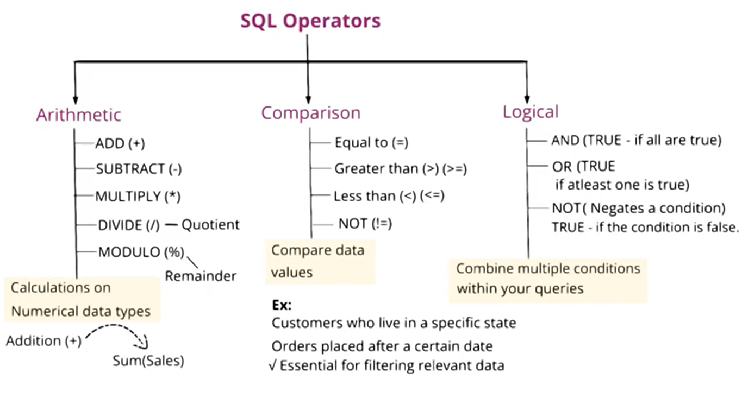
DBMS -UNIT-2

Slide 76
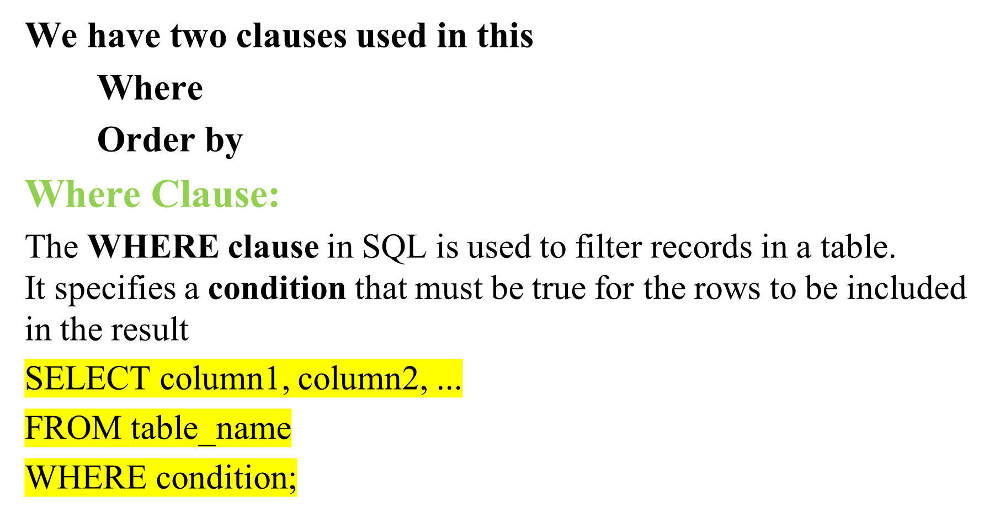
CONDITIONAL SELECTIONS AND OPERATORS

Slide 77
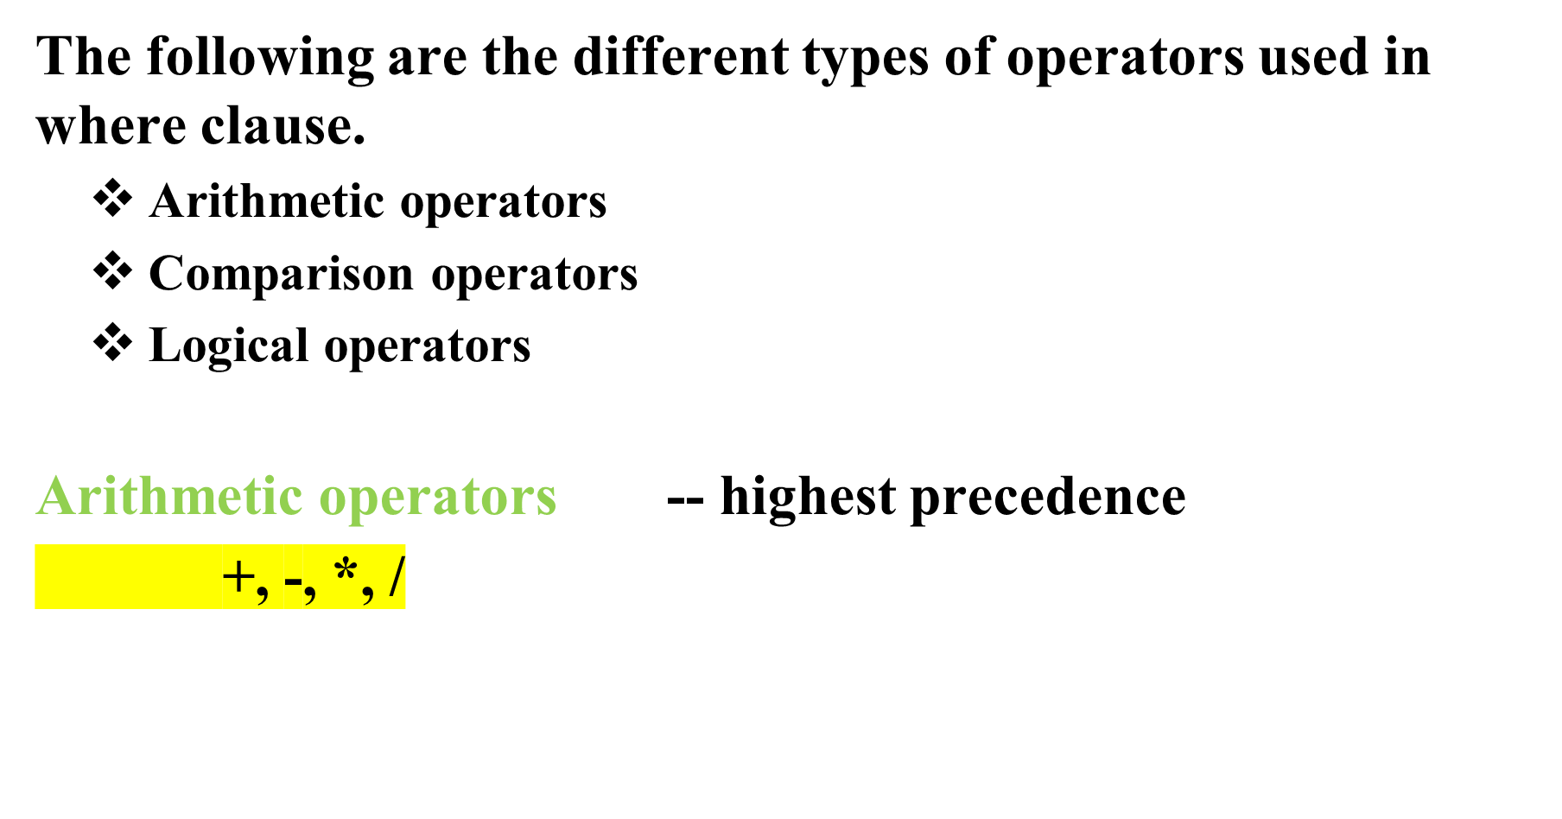

Slide 78
Comparison operators
=, !=, >, <, >=, <=, <>
between, not between
in, not in
is null, is not null
like
Logical operators
And
Or -- lowest precedence
not

Slide 79
using =, >, <, >=, <=, !=, <>
SQL> select * from student where Sno = 2;
SQL> select * from student where Sno < 2;
SQL> select * from student where Sno > 2;
SQL> select * from student where Sno <= 2;
SQL> select * from student where Sno != 2;

Slide 80

using AND

Slide 81

using OR

Slide 82
using BETWEEN
This will gives the output based on the column and its lower bound, upperbound.
Syntax:
select * from <table_name> where <col> between <lower bound> and <upper bound>;
Ex:
SQL> select * from student where marks between 70 and 98;

Slide 83

using NOT BETWEEN

Slide 84

using IN

Slide 85

using NOT IN

Slide 86

using NULL

Slide 87

using NOT NULL

Slide 88

using LIKE

Slide 89
ii) This will give the rows whose name start with ‘S’.
SQL> select * from student where Name like 'S%’;
iii) This will give the rows whose name ends with ‘h’.
SQL> select * from student where name like ‘%a’;
iV) This will give the rows whose name’s second letter start with ‘a’.
SQL> select * from student where name like '_a%';

Slide 90
v) This will give the rows whose name’s third letter start with ‘d’.
SQL> select * from student where name like ‘__h%’;
vi) This will give the rows whose name’s second letter start with ‘t’ from ending.
SQL> select * from student where name like '%t_’;
vii) This will give the rows whose name’s third letter start with ‘e’ from ending.
SQL> select * from student where name like '%e__’;
viii) This will give the rows whose name cotains 2 a’s.
SQL> select * from student where name like '%a% a %';

Slide 91
Not matching a pattern using NOT LIKE:
SELECT ename FROM employees
WHERE ename NOT LIKE '%a%’;
Matches employees whose name does not contain 'a'.

Slide 92

using ORDER BY

Slide 93
AGGREGATE OPERATORS (Functions)
DBMS -UNIT-2

Slide 94

Aggregate Operators(Functions)

Slide 95
SQL supports aggregate operations, which can be applied on any column, say A, of a relation:
1. COUNT ([DISTINCT] A): The number of (unique) values in the A column.
2. SUM ([DISTINCT] A): The sum of all (unique) values in the A column.
3. AVG ([DISTINCT] A): The average of all (unique) values in the A column.
4.MAX(A) : The Maximum value in the A Column.
5.MIN(A) : The Minimum value in the A Column,

Slide 96

GROUP BY Clause

Slide 97
HAVING Clause
The HAVING clause is used to filter groups created by the GROUP BY clause.
It applies conditions on aggregated data and is typically used with aggregate functions like SUM, AVG, or COUNT. Unlike the WHERE clause, which filters rows before grouping, the HAVING clause filters groups after the grouping process.
Key Features of the HAVING Clause:
Filters groups based on conditions involving aggregate functions.
Always used after the GROUP BY clause.
Works with aggregate functions such as SUM, COUNT, AVG, MIN, MAX.

Slide 98
Having clause
Syntax:
SELECT column name(s) FROM table name
WHERE condition
GROUP BY column_name(s) HAVING condition
ORDER BY column_name(s);
WHERE vs HAVING
WHERE → filters rows before grouping.
HAVING → filters groups after grouping.
So:
WHERE works on individual rows.
HAVING works on aggregate results (SUM, AVG, COUNT, etc.).

Slide 99


Slide 100

COUNT():

Slide 101

Examples

Slide 102


Slide 103

SUM()

Slide 104


select sum(sal) from emp; 299025.00
select sum(sal) from emp where job='analyst’; 93000.00
select sum(sal) from emp where deptno=10; 102750.00
select job, sum(sal) from emp group by job;

Slide 105

AVG()

Slide 106

MAX() and MIN()

Slide 107


Slide 108
LOGICAL DATABASE DESIGN
DBMS -UNIT-2

Slide 109
LOGICAL DATABASE DESIGN: ER TO RELATIONAL
choose a DBMS to implement our database design, and convert the conceptual database design into a database schema in the data model of the chosen DBMS. We will consider only relational DBMS
We now describe how to translate an ER diagram into a collection of tables with associated constraints, that is, a relational database schema.
Logical database design is the process of deciding how to arrange the attributes of the entities in a given business environment into database structures, such as the tables of a relational database
.
The first step before applying the rules in relational data model is converting the conceptual design to a form suitable for relational logical model, which is in a form of tables.
DBMS -UNIT-2

Slide 110

Converting ER Diagram to Relational Tables
DBMS -UNIT-2

Slide 111
Entity Sets to Tables
An entity set is mapped to a relation in a straight forward way: Each attribute of the entity set becomes an attribute of the table.
Note that we know both the domain of each attribute and the (primary) key of an entity set.
CREATE TABLE Employees
(ssn VARCHAR(11),
name VARCHAR(20),
lot INT,
PRIMARY KEY (ssn)
);
name
ssn lot
Employees
DBMS -UNIT-2

Slide 112


Entity set with multi valued attribute
DBMS -UNIT-2

Slide 113

Entity set with Composite attribute:
DBMS -UNIT-2

Slide 114
Relationship Sets (without Constraints) to Tables
A relationship set, like an entity set, is mapped to a relation in the relational model.
To represent a relationship, we must be able to identify each participating entity and give values to the descriptive attributes of the relationship.
Thus, the attributes of the relation include:
  The primary key attributes of each participating entity set, as foreign key fields.
  The descriptive attributes of the relationship set.
DBMS -UNIT-2

Slide 115

All the available information about the Works-ln3 table is captured by the following SQL definition:
CREATE TABLE Works_In3 ( ssn CHAR(11), did INTEGER,
address CHAR(20) ,
since DATE,
PRIMARY KEY (ssn, did, address),
FOREIGN KEY (ssn) REFERENCES Employees (ssn),
FOREIGN KEY (address) REFERENCES Locations(address),
FOREIGN KEY (did) REFERENCES Departments(did));
DBMS -UNIT-2

Slide 116

Finally, consider the Reports_To relationship set.
The role indicators supervisor and subordinate are used to create meaningful field names in the CREATE statement for the Reports_To table:
CREATE TABLE Reports_To ( supervisor_ssn CHAR (11),
subordinate_ssn CHAR (11) ,
PRIMARY KEY (supervisor_ssn, subordinate_ssn),
FOREIGN KEY (supervisor_ssn) REFERENCES Employees(ssn),
FOREIGN KEY (subordinate_ssn) REFERENCES Employees(ssn) )
Observe that we need to explicitly name the referenced field of Employees because the field name differs from the name(s) of the referring field(s).
DBMS -UNIT-2

Slide 117


Translating Relationship Sets with Key Constraints
Review: Key Constraints
Each dept has at most one manager, according to the key constraint
on Manages.
DBMS -UNIT-2

Slide 118
Because each department has at most one manager, no two tuples can have the same did value but differ on the ssn value.
A consequence of this observation is that did is itself a key for Manages; indeed, the set did, ssn is not a key (because it is not minimal).
The Manages relation can be defined using the following SQL statement:
CREATE TABLE Manages(
ssn CHAR(11), did INTEGER,
since DATE, PRIMARY KEY (did),
FOREIGN KEY (ssn) REFERENCES Employees (ssn),
FOREIGN KEY (did) REFERENCES
Departments(did))
DBMS -UNIT-2

Slide 119
A second approach: Since each department has a unique manager, we could instead combine Manages and Departments.
This approach eliminates the need for a separate Manages relation, and queries asking for a department's manager can be answered without combining information from two relations.
The only drawback to this approach is that space could be
wasted if several departments have no managers.
In this case the added fields would have to be filled with
null values.
CREATE TABLE Dept_Mgr( did INTEGER,
dname CHAR(20), budget REAL,
ssn CHAR(11),
since DATE,
PRIMARY KEY (did),
FOREIGN KEY (ssn) REFERENCES Employees(ssn))
DBMS -UNIT-2

Slide 120

Translating Relationship Sets with Participation Constraints
Every department is required to have a manager, due to the participation constraint, and at most one manager, due to the key constraint.
CREATE TABLE Dept_Mgr(
did INTEGER,
dname CHAR(20),
budget REAL,
ssn CHAR(11) NOT NULL,
since DATE,
PRIMARY KEY (did),
FOREIGN KEY (ssn)
REFERENCES Employees(ssn),
ON DELETE NO ACTION)
DBMS -UNIT-2

Slide 121

DBMS -UNIT-2

Slide 122

Translating Weak Entity Sets
A weak entity set always participates in a one-to-many binary relationship and has a key constraint and total participation.
A Dependents entity can be identified uniquely only if we take the key of the owning Employees entity and the pname of the Dependents entity, and the Dependents entity must be deleted if the owning Employees entity is deleted.
DBMS -UNIT-2

Slide 123
Weak entity set and identifying relationship set are translated into a single table.
– When the owner entity is deleted, all owned weak entities must
also be deleted.
CREATE TABLE Dep_Policy ( pname CHAR(20),
age INTEGER,
cost REAL,
ssn CHAR(11) NOT NULL,
PRIMARY KEY (pname, ssn),
FOREIGN KEY (ssn) REFERENCES Employees(ssn),
ON DELETE CASCADE)
DBMS -UNIT-2

Slide 124

Translating Class Hierarchies
Overlap constraints:
Can Joe be an Hourly_Emps as well as a Contract_Emps entity? (Allowed/disallowed)
Covering constraints:
Does every Employees entity also have to be an Hourly_Emps or a
Contract_Emps entity? (Yes/no)
DBMS -UNIT-2

Slide 125
General approach:
  3 relations: Employees, Hourly_Emps and Contract_Emps.
    Hourly_Emps: Every employee is recorded in Employees. For hourly emps, extra info recorded in Hourly_Emps (hourly_wages, hours_worked, ssn); must delete Hourly_Emps tuple if referenced Employees tuple is deleted).
    Queries involving all employees is easy, those involving just Hourly_Emps require a join to get some attributes.
Alternative: Just Hourly_Emps and Contract_Emps.
  Hourly_Emps: ssn, name, lot, hourly_wages, hours_worked.
  Each employee must be in one of these two subclasses.
DBMS -UNIT-2

Slide 126


Translating ER Diagrams with Aggregation
DBMS -UNIT-2

Slide 127
There is a special case in which this translation can be refined by dropping the Sponsors relation.
Consider the Sponsors relation. It has attributes pid, did,and since; and in general we need it (in addition to Monitors) for two reasons:
We have to record the descriptive attributes (in our example, since) of the Sponsors relationship.
Not every sponsorship has a monitor, and thus some (pid, did) pairs in the Sponsors relation may not appear in the Monitors relation.
However, if Sponsors has no descriptive attributes and has total participation in Monitors, every possible instance of the Sponsors relation can be obtained from the (pid, did) columns of Monitors; Sponsors can be dropped.
DBMS -UNIT-2

Slide 128

ER to Relational: Additional Examples
The key constraints allow us to combine Purchaser with Policies and Beneficiary with Dependents.
Participation constraints lead to NOT NULL constraints.
What if Dependents is a weak entity set?
DBMS -UNIT-2

Slide 129
CREATE TABLE Policies ( policyid INTEGER, cost REAL,
ssn CHAR(11) NOT NULL,
PRIMARY KEY (policyid).
FOREIGN KEY (ssn) REFERENCES Employees(ssn),
ON DELETE CASCADE)
CREATE TABLE Dependents ( pname CHAR(20), age INTEGER,
policyid INTEGER, PRIMARY KEY (pname, policyid).
FOREIGN KEY (policyid) REFERENCES Policies(policyid),
ON DELETE CASCADE)
DBMS -UNIT-2

Slide 130

1:M (one to many) Relationship:
DBMS -UNIT-2

Slide 131

DBMS -UNIT-2

Slide 132

M:1 (many to one) Relationship:
DBMS -UNIT-2

Slide 133
In this scenario, every student can enroll only in one elective course but for an elective course there can be more than one student.
First Convert each entity and relationship to tables.
Student table corresponds to Student Entity with key as S-Id.
Similarly Elective_Course table corresponds to Elective_Course Entity with key as E-Id.
Enrolls Table represents relationship between Student and Elective_Course (Which student enrolls in which course).
So it will take attribute S-Id from and Student E-Id from Elective_Course.
DBMS -UNIT-2

Slide 134

M:N (many to many) Relationship:
Consider same relationship set enrolled exist between entity sets student and course ,which means multiple student can enroll in multiple courses.
DBMS -UNIT-2

Slide 135


DBMS -UNIT-2

Slide 136

1:1 (one to one) Relationship:
Consider same relationship set enroll exist between entity sets student and course ,which means one student can enroll in only one courses
DBMS -UNIT-2

Slide 137


DBMS -UNIT-2

Slide 138

DBMS -UNIT-2

Slide 139
INTRODUCTION TO VIEWS
DBMS -UNIT-2

Slide 140

View Definition
DBMS -UNIT-2

Slide 141
Advantages of Views
Simplicity – Users don’t need to remember complex queries.
Security – Hide sensitive columns (like salary, password).
Consistency – Same query logic reused by many users.
Data abstraction – Users interact with views, not raw tables..
DBMS -UNIT-2

Slide 142
Types of Views
1. Simple View:
    Based on a single table.
    Supports DML operations.
2. Complex View
    Based on multiple tables (joins, subqueries).
    Generally, not updatable.
DBMS -UNIT-2

Slide 143

Creating Simple VIEW
DBMS -UNIT-2

Slide 144

Creating View from a single table
DBMS -UNIT-2

Slide 145
Creating Complex View from multiple tables
View from multiple tables can be created by simply include multiple tables in the SELECT statement.
SYNTAX:
CREATE VIEW MarksView AS
SELECT Table1.colname1, Table1.colname2, Table2.colname3
FROM Table1,Table2
WHERE table1.colname4=table2.colname2;
DBMS -UNIT-2

Slide 146
Example
In the given example, a view is created named MarksView from two tables Student_Detail and Student_Marks.
CREATE VIEW MarksView AS
SELECT StudentDetails.NAME, StudentDetails.ADDRESS, StudentMarks.MARKS
FROM StudentDetails, StudentMarks
WHERE StudentDetails.NAME = StudentMarks.NAME;
DBMS -UNIT-2

Slide 147

Querying a View
DBMS -UNIT-2

Slide 148
Views and Security
Given YoungStudents, but not Students or Enrolled, we can find students s
who have are enrolled, but not the cid’s of the courses they are enrolled in.
CREATE VIEW YoungActiveStudents AS SELECT S.name as name, E.grade as grade
FROM Students as S, Enrolled as E
WHERE S.sid = E.sid and S.age<21
DBMS -UNIT-2

Slide 149
A view is just a relation, but we store a definition, rather than a set of tuples.
Eg: Create view Students_B as select S.sid,S.name,E.cid From Students as S,
Enrolled as E where S.sid=E.sid
DBMS -UNIT-2

Slide 150

Update SQL View
DBMS -UNIT-2

Slide 151

Update SQL View
DBMS -UNIT-2

Slide 152
VIEW Creation WITH CHECK OPTION
Ensures modifications through the view do not violate its condition.
VIEW Creation:
CREATE VIEW sales_staff AS
SELECT empno, ename, job, sal
FROM emp
WHERE job = 'SALESMAN’
WITH CHECK OPTION;
Note: If you try to INSERT or UPDATE an employee with job ≠ 'SALESMAN' using this view, MySQL will reject it.
DBMS -UNIT-2

Slide 153

Altering View
DBMS -UNIT-2

Slide 154

Destroying View
DBMS -UNIT-2

Slide 155

Destroying Multiple Views
DBMS -UNIT-2

Slide 156

Checking View Definition
DBMS -UNIT-2

Slide 157

DBMS -UNIT-2

